Slide 1


TOPICAL EXOSOME TREATMENT

Slide 2


Please Note:
The information in this presentation is not intended to provide professional medical advice for diagnosis or treatment; all content is general information provided for informational purposes only. It was written to help you understand the product, so please use it for reference only.
EXPLORE MORE

Slide 3
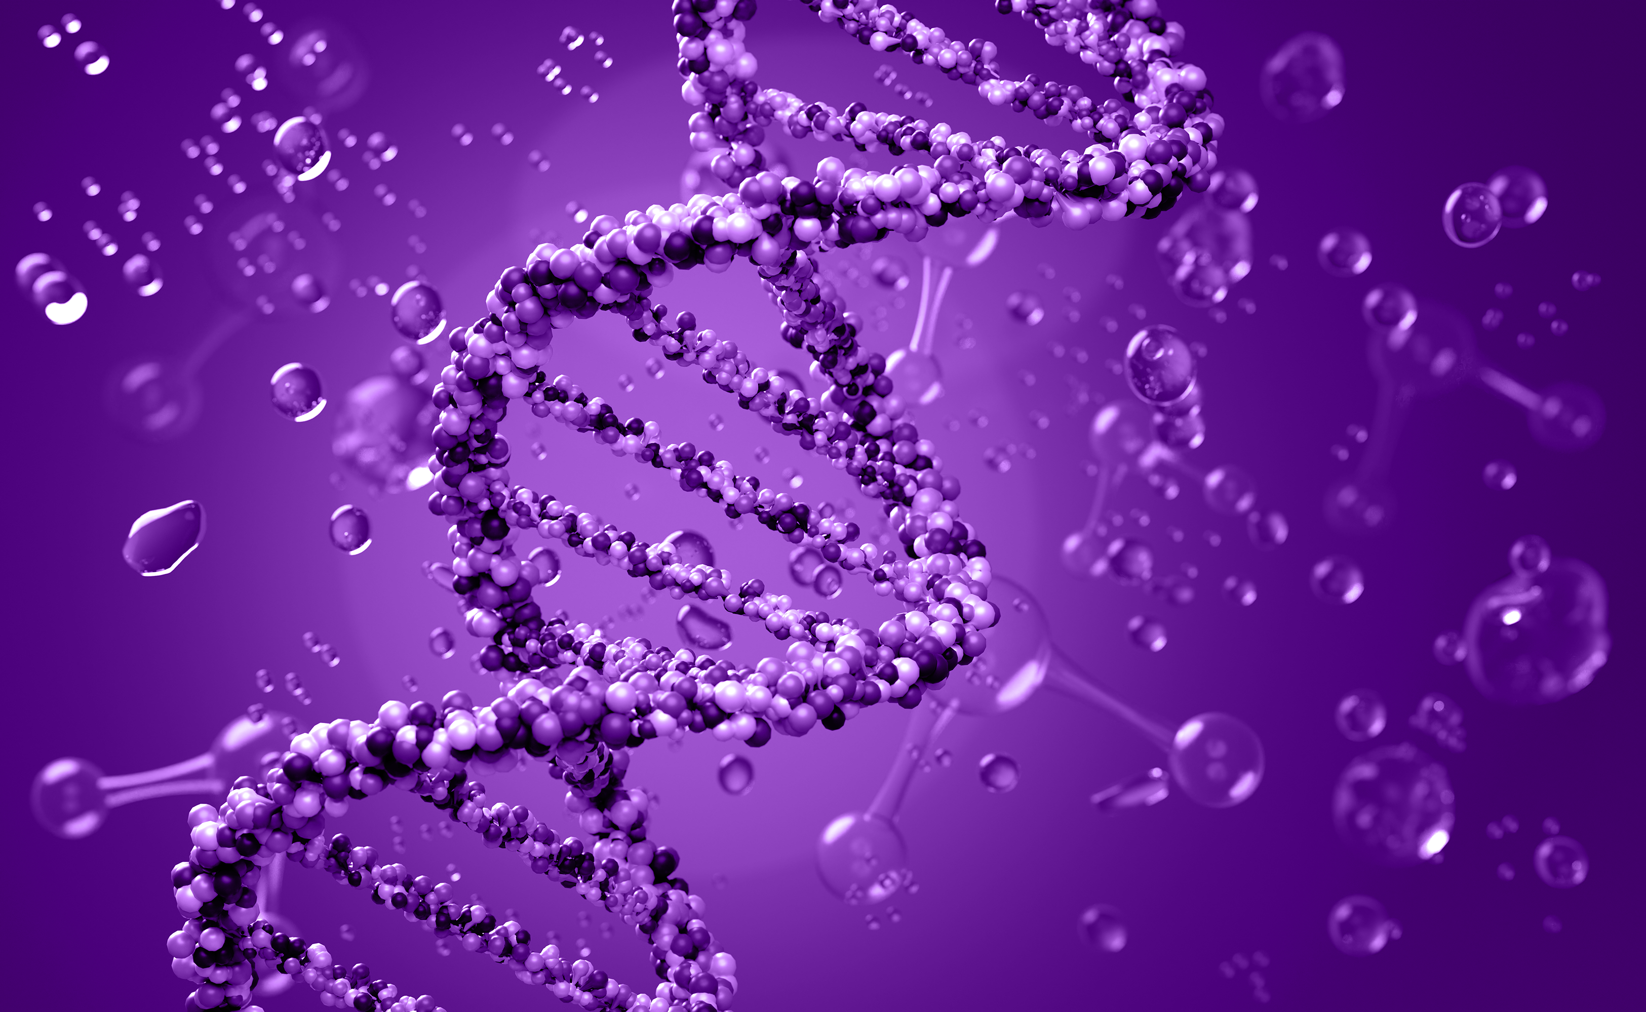
Exosome
1

Slide 4
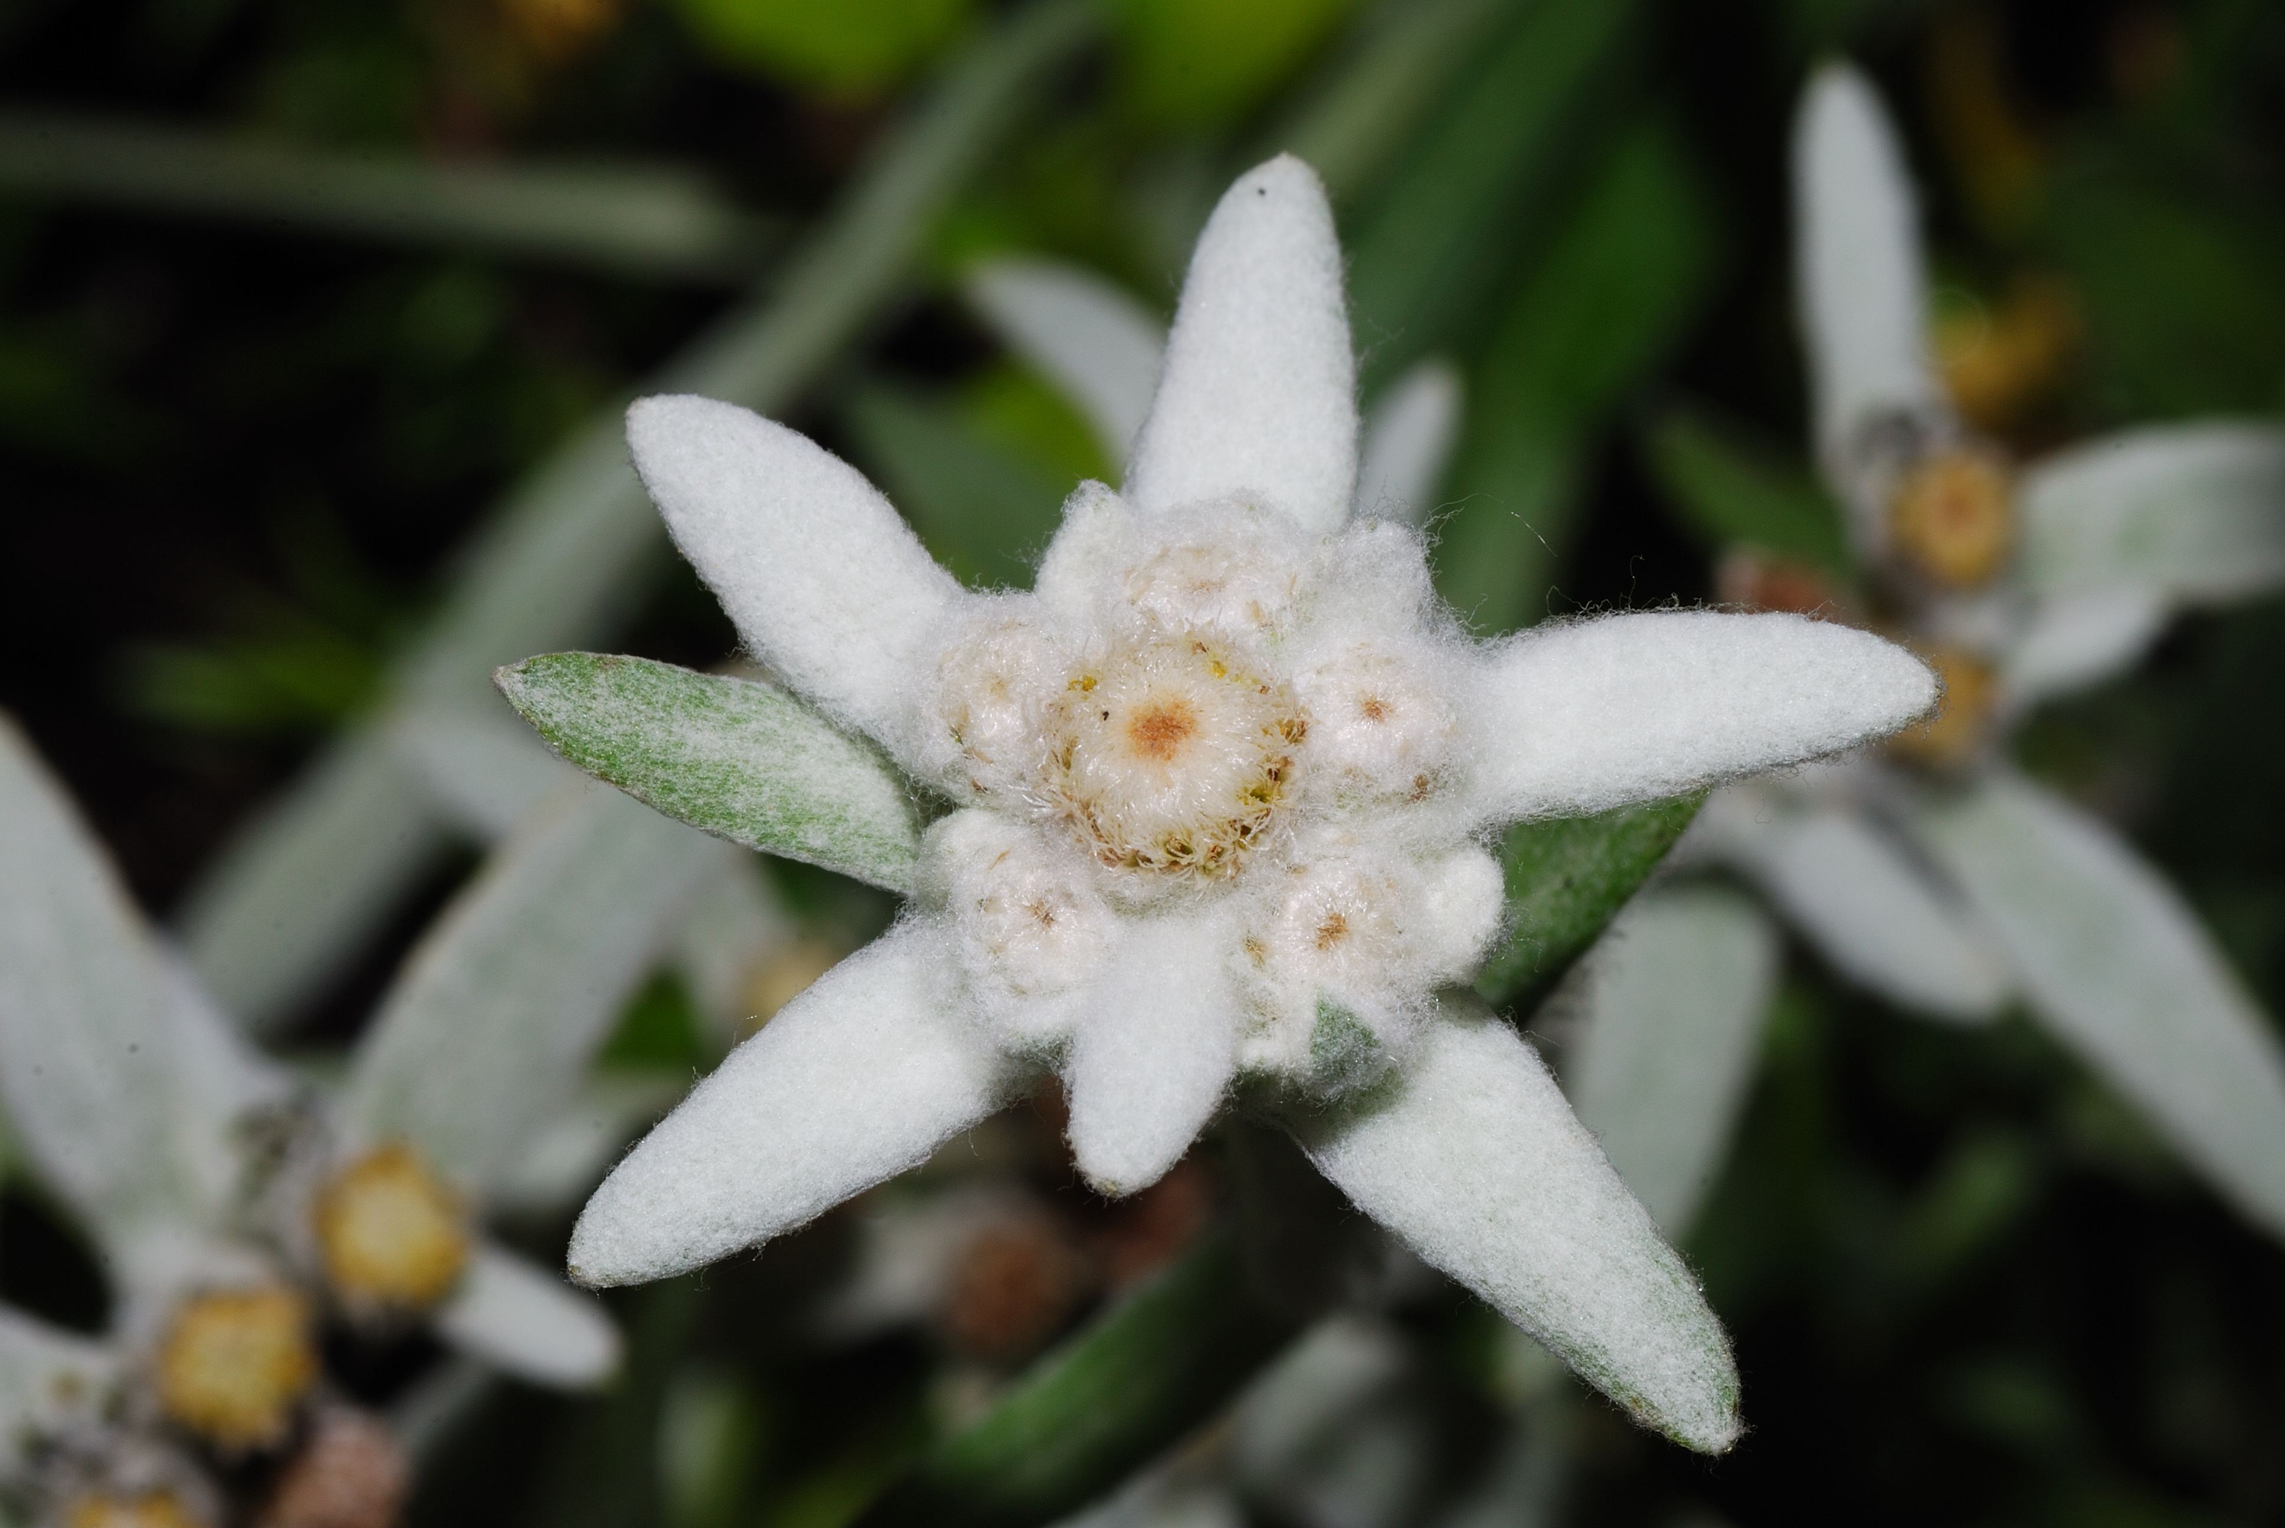

Exosome
Adipose-Derived
Stem Cell Exosome
Edelweiss-Derived
Exosome
Skin Lactobacillus
-Derived Exosome
Adipose-derived Stem Cell Exosome : Strong skin improvement effect with about 250 kinds of growth factors
Edelweiss-derived exosome : Anti-aging effect by removing active oxygen
Skin Lactobacillus-derived exosome: Powerful anti-inflammatory effect reduces acne-causing strains

Slide 5
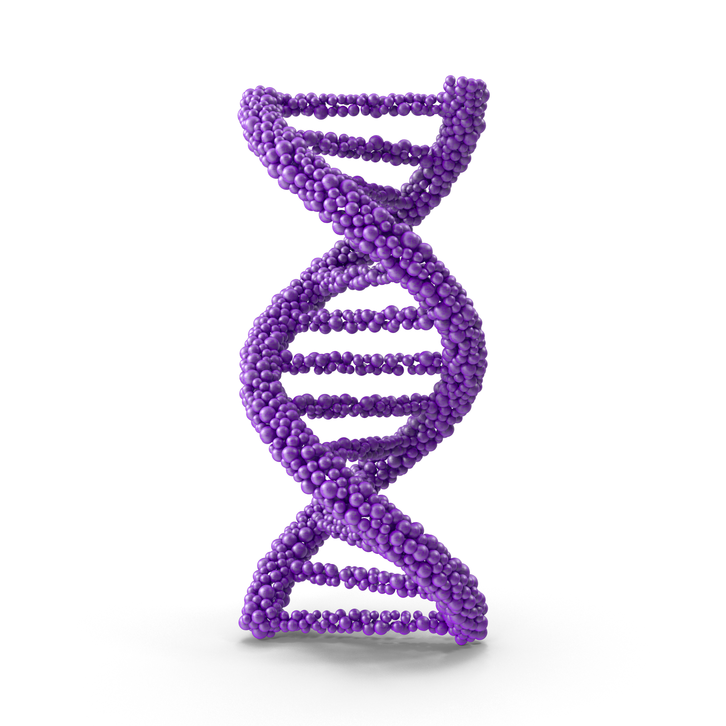
Adipose-Derived
Stem Cell Exosome
It contains about 250 kinds of growth factors, so it promotes various cell division, growth and differentiation
Contains about 250 kinds of growth factors to promote various cell division, growth and differentiation
Contains exosomes
- Only 0.1% of stem cell culture medium exists
- Nano vesicles with a size of 50-200 nm, containing various genetic information materials within cell
Contains cytokines
- One of the peptides as a glycoprotein that acts as a signal substance in the body
- Combines with receptors of target cells to express various activation mechanisms within cells

Slide 6
Adipose-Derived
Stem Cell Exosome
It contains about 250 kinds of growth factors, so it promotes various cell division, growth and differentiation
01 Obtaining adipose tissue and securing adipose-derived stem cells
03 Exosome Detection
Exosome Analysis equipment
Confirmed by Brownian motion of particles by NTA (Nanoparticle Tracking Analysis) analysis [number of particles (Particle/mL), particle size]
TEM image analysis (Transmission electron microscopy)
Exosomal specific markers (CD9, CD63, CD81(Tetraspanin), TSG101, Flotillin1, Alix etc.)
Securing adipose tissue
Securing fat-derived stem cells
Securing adipose-derived stem cell culture medium
02 Donor eligibility check
Confirmation of donor eligibility
Confirmation of congenital or chronic disease test
Confirmation of contagious spongiform encephalopathy test
Consent to use adipose tissue’

Slide 7
Adipose-Derived Stem Cell Conditioned Media — Main Ingredients
Exotop™ contains high concentrations of growth factors (EGF, HGF, VEGF, TGFβ, FGF, KGF, GF-1) and extracellular matrix proteins (Collagen, Fibronectin).
EGF
HGF
VEGF
TGFβ
FGF
KGF
IGF–1
Extracellular Matrix

Slide 8
It contains about 250 kinds of growth factors, so it promotes various cell division, growth and differentiation.
Adipose-Derived Stem Cell Conditioned Media — Growth Factors
Growth Factors & Functions
EGF
VEGF
Promotes cell proliferation. Promotes angiogenesis.
Promotes hair growth.
Promotes angiogenesis.
Promotes fibroblast proliferation. Inhibits scar formation in wounds.
HGF
TGFβ
Anti-inflammatory function.
Promotes cell migration and proliferation. Inhibits apoptosis. Promotes angiogenesis. Promotes hair growth.
Damaged tissue repair.
Regulation of immune cell proliferation.

Slide 9
It contains about 250 kinds of growth factors, so it promotes various cell division, growth and differentiation.
Adipose-Derived Stem Cell Conditioned Media — Growth Factors
Growth Factors & Functions
aFGF
KGF
Promotes epithelial cell proliferation. Promotes production of collagen, hyaluronic acid, SOD, etc.
in fibroblasts.
Promotes keratinocyte proliferation.
GF-1
bFGF
Promotes tissue regeneration. Promotes tissue growth.
Skin dermal regeneration factor. Wound healing effect.

Slide 10
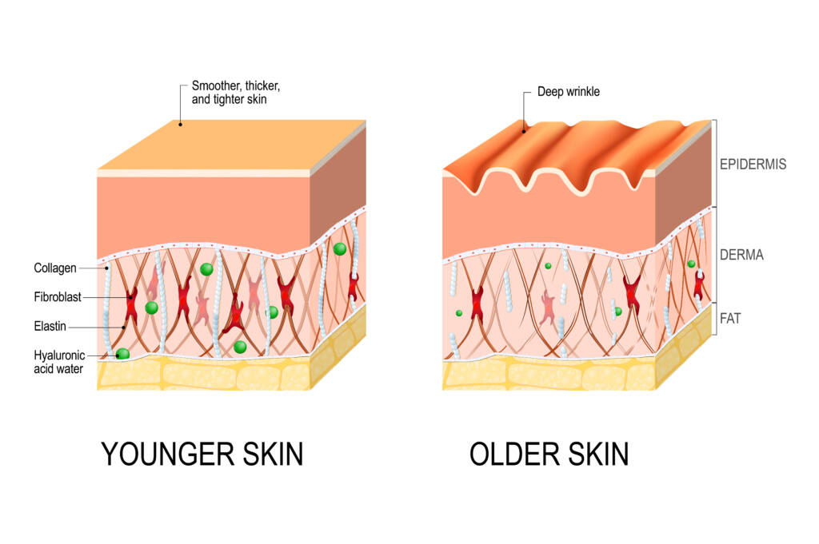
Adipose-Derived Stem Cell Conditioned Media — Collagen & Fibronectin
ECM physically supports tissues by filling in the gaps between cells or surrounds cells to create an environment for cells to survive.
*(Left) Skin with sufficient extracellular matrix
(Right) Skin with insufficient extracellular matrix
Collagen
Maintain skin elasticity & strengthen skin tissue.
Fibronectin
Wound healing effect with skin components.

Slide 11
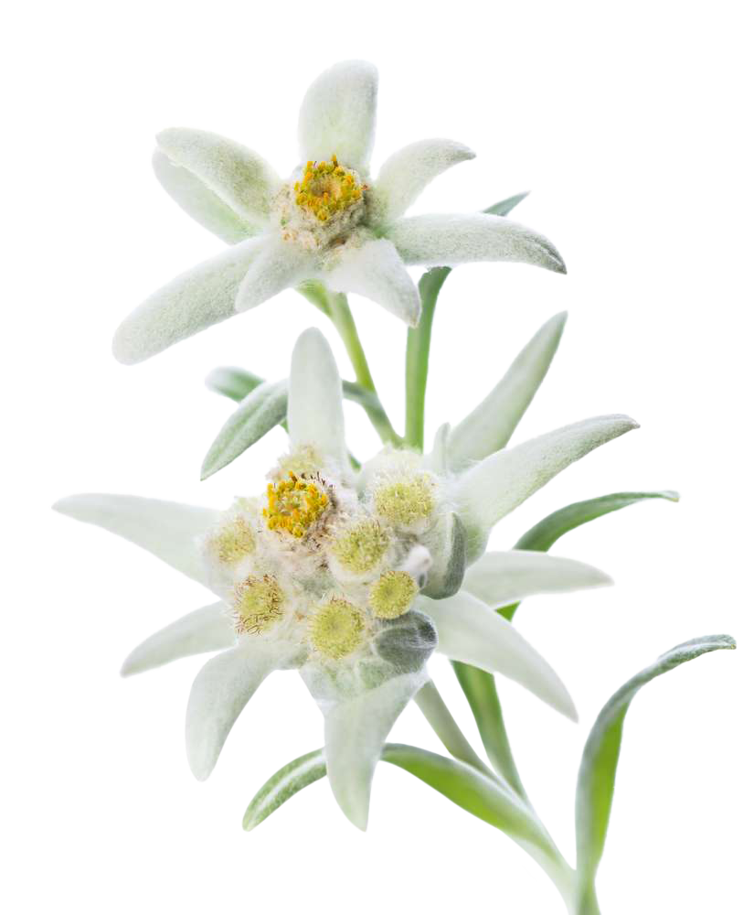
Edelweiss-Derived
Exosome
Exosome extracted from edelweiss, which is said to be a gift from nature for skin.
It has antioxidant properties, so it is effective for skin care and is used as a raw material for cosmetics in many countries around the world.
Relieves skin troubles caused by external stimuli by promoting the cycle of the skin and participating in the formation of new skin layers
Glycoflavonoids and leontopodicacids soothe and protect the skin
Helps to alleviate skin damage and aging caused by UV rays
Prevents skin aging by suppressing active oxygen that causes skin aging

Slide 12
Edelweiss-Derived
Exosome
02 Plant-Derived Exosome
Can deliver anti-cancer or antioxidant factors to tumor cells
Compared to synthetic nanomaterials, when reacting to normal host cells, it does not induce immune or inflammatory responses and does not cause toxicity, immunogenicity, or allergic problems.
Can pass through cell membranes and has biocompatibility with mammalian cells
It passes through the blood vessel and brain barrier, but does not pass through the placenta and does not affect the fetus, so it can be applied to pregnant women
Exosome extracted from edelweiss, which is said to be a gift from nature for skin.
01 Edelweiss-Derived Exosome
It is produced in the Multi-Vesicular body (MVB) in the cytoplasm and secreted into the apoplast.
It binds to the receptor of the target cell and directly regulates the mechanism.
Delivery of siRNA and RNA from donor cells.
Acting as a carrier to deliver drugs.
*Apoplast : space between cell membrane and cell wall

Slide 13
Edelweiss-Derived
Exosome
Exosome extracted from edelweiss, which is said to be a gift from nature for skin.
01 Establishment of Plant Callus Line-Up
Plant
1st Plant Callus Culture
2nd Plant Callus Culture
Percolation
Massive Production
02 Donor Establishment of Independent Exosome Production/Isolation/Test Method
Production: Maximize exosome secretion
Isolation: High yield & high purity exosome
Inspection: Introduction of the latest equipment

Slide 14
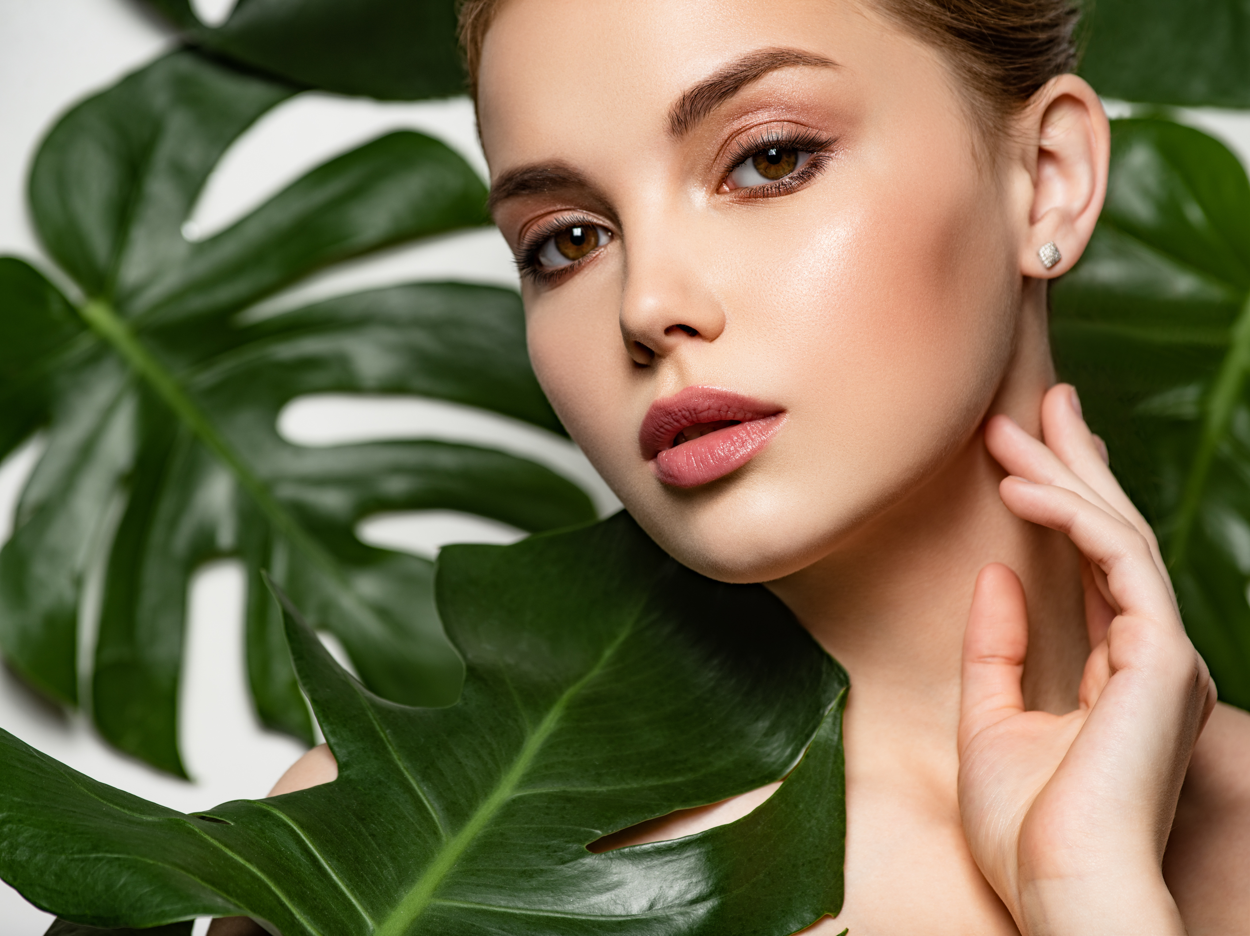
Skin Lactobacillus-Derived Exosome
Made from fermented lactic acid bacteria from the skin of individuals in their 20’s, it is effective in skin whitening and
anti-inflammatory effects.
Identification of skin-derived lactic acid bacteria with more accurate sequencing technology than before isolation and identification of skin strains
Confirmation of lactic acid bacteria as a result of microorganism isolation and DNA identification from skin isolation of lactic acid bacteria from the skin of individuals in their 20’s
Lactobacillus planatarum
Skin in their 20’s contains about 1.23%, approximately 25 times more than those in their 50’s.
Reduction of acne-causing strains, anti-inflammatory effect, increase in lactic acid bacteria, strengthening of skin immunity, skin moisturizing, regeneration, anti-aging, protective film formation, tone-up, etc.

Slide 15
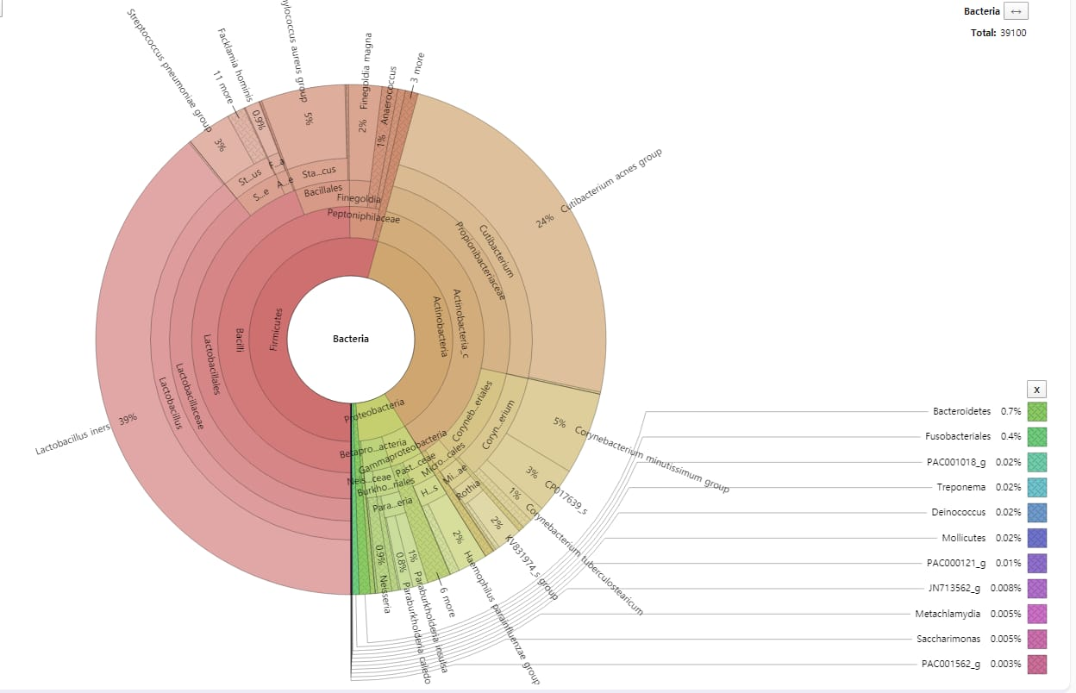
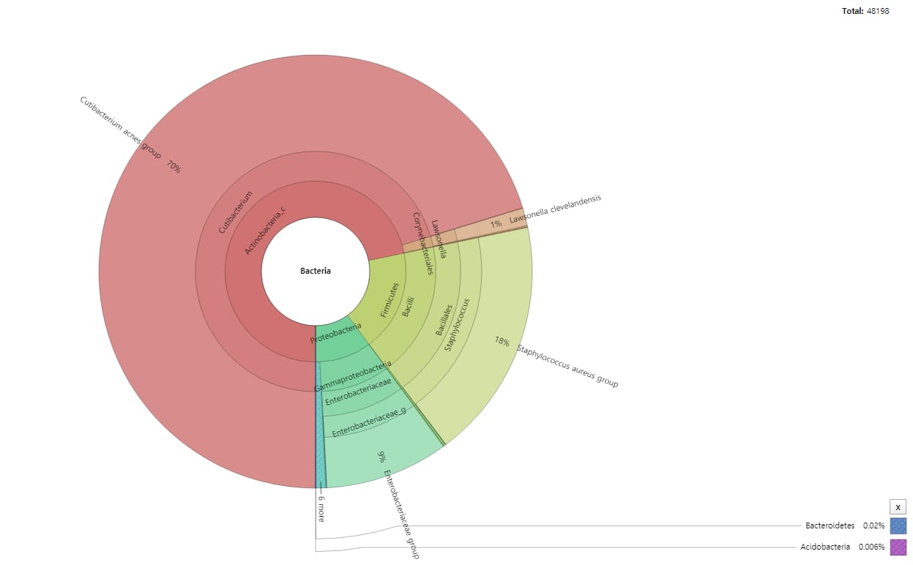
Skin Lactobacillus-Derived Exosome
Made from fermented lactic acid bacteria from the skin of individuals in their 20’s, it is effective in skin whitening and
anti-inflammatory effects.
[ Comparison graph before and after application ]
Confirmation of reduction of acne-causing strains and increase of lactic acid bacteria after application

Slide 16

Exotop’s™ unique combination of three types of exosomes is more effective for skin regeneration, inflammation relief, and whitening.
Manufacturing Facility:
Class 100 (Aseptic Process Clean Facility 1B)
Classification:
Adipose-derived Stem Cell Exosome
Edelweiss-Derived Exosome
Skin Lactobacillus-derived exosome
Formulation:
Liquid
Characteristics:
In the culture process, antibiotics are not used at all and class 100 manufacturing overcomes the limitations of existing culture medium

Slide 17
Exotop’s™ unique combination of three types of exosomes is more effective for skin regeneration, inflammation relief, and whitening.
Ingredients:
High-purity exosome, about 250 kinds of cytokines, growth factors, ECM
High-purity exosomes, glycoflavonoids, leontopodic acid
High-purity exosome (Lactobacillus sp, active ingredient of Postbiotics)
Efficacy:
Promotes cell division, growth and differentiation
Skin soothing/protection, skin damage and aging relief
Regeneration, anti-inflammatory, immune regulation, tone up
Cycle:
1~2 times/month

Slide 18

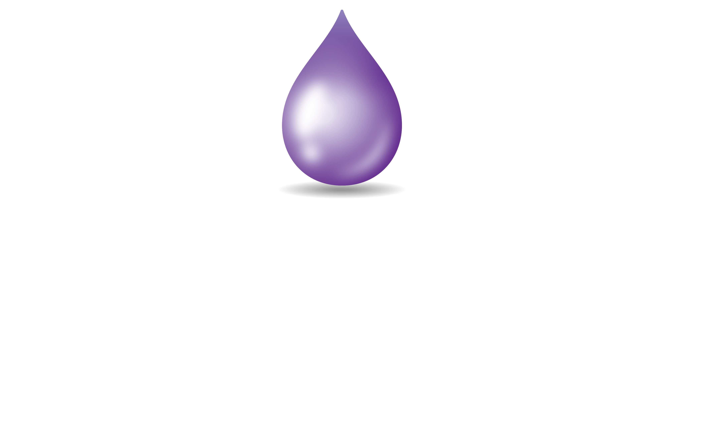
EXOTOP™
2

Slide 19

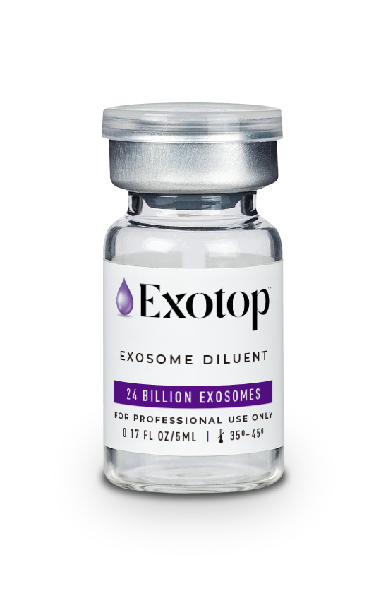
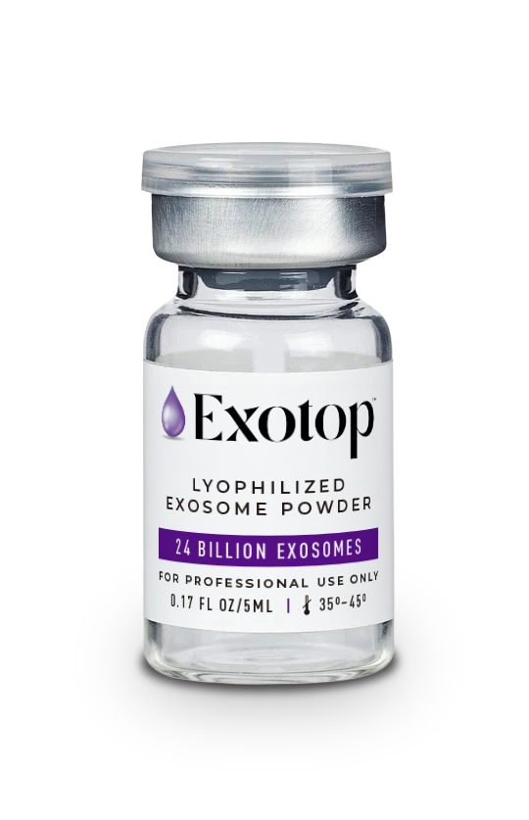
3 Different Types of Exosomes
Exotop™ changes the skin from the root.
Experience the unique skin regenerative effects
of Exotop™ provided by the combination of 3 different exosomes.

Slide 20
EXOTOP™
01
03
Produced within the pristine confines of a state-of-the-art NASA Class 100 clean room, ensuring the utmost precision and quality.
Experience an unprecedented fusion of exosomes and stem cells, pioneering a realm of rejuvenation and vitality like never before.
No Preservatives or Antibiotics
Class 100 Manufacturing Facility
Contains 3 Types of Exosomes
02
Impeccably cultivated without the utilization of any antibiotics, ensuring a pure and wholesome product.

Slide 21
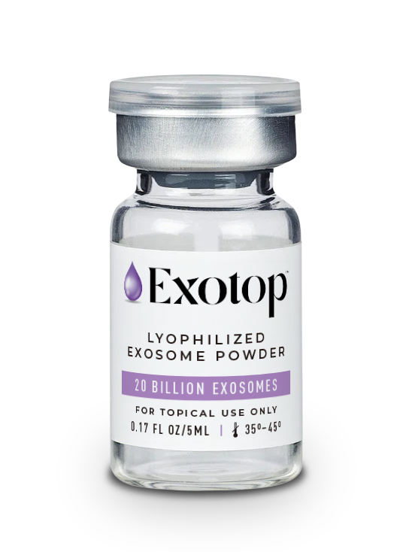
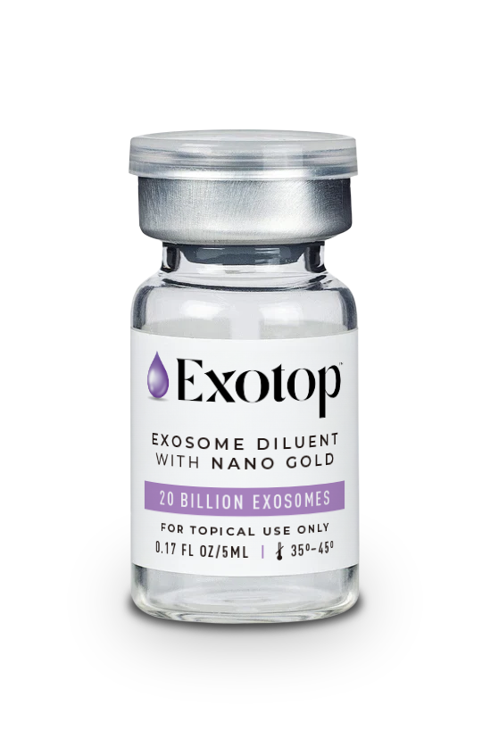
EXOTOP™
Unlock the secrets of timeless beauty with Exotop’s exclusive blend, a potent serum that swiftly addresses the telltale signs of aging, reinstating firmness, strength, and vitality to your skin.
Elastic, Wrinkle-Free Skin
Fair Tone
Smooth Texture
Moisture Sans Tightness
Radiant Glow
Resilient Skin Barrier

Slide 22
EXOTOP™
Indulge in the epitome of skincare luxury – a premium skin booster enriched with a concentrated blend of three exosome complexes, elevating your beauty regimen to unprecedented heights.
01
02
03
Adipose-Derived Stem Cell Exosome
Edelweiss-Derived Exosome
Skin Lactobacillus-Derived Exosome
A robust skin enhancement effect fueled by approximately 250 various growth factors.
A formula that not only prevents the aging process but also skillfully inhibits active oxygen.
Fermented lactic acid bacteria extracted from the skin of those in their 20’s, produces a skin lightening, anti-inflammatory benefit.
Nurture youthful and vibrant skin by delivering a potent infusion of concentrated nutrition to address the subtle signs of aging.

Slide 23

MAIN INGREDIENTS
Adipose-Derived Stem Cell Exosome
Growth
Factors
Edelweiss-Derived Exosome
Cytokine
Skin Lactobacillus-Derived Exosome
Extracellular
Matrix
Tranexamic
Acid
Gluthaione

Slide 24

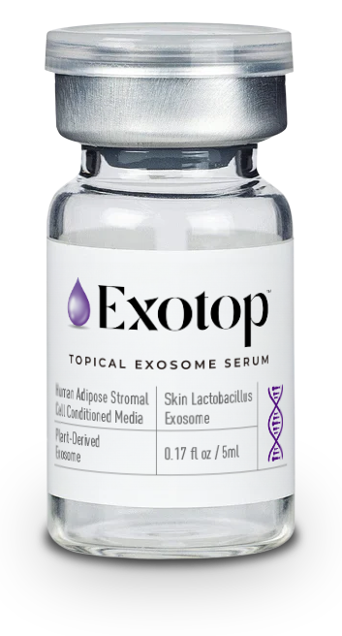
Enhance your skin’s innate ability to self-renew.
3 Different Types of Exosomes
Encounter the epitome of regenerative excellence with Exotop's groundbreaking fusion of 3D exosomes—a truly unique solution crafted for unparalleled skin rejuvenation.

Slide 25

References
3

Slide 26
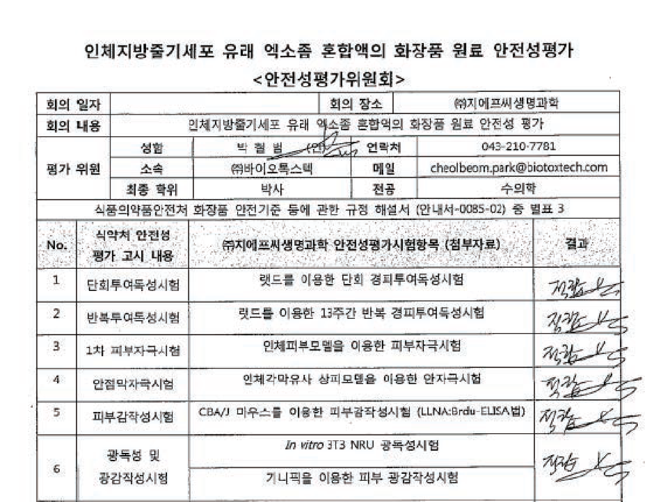
Adipose-Derived Stem Cell Exosome
Cosmetic Raw Material Stability Evaluation

Slide 27
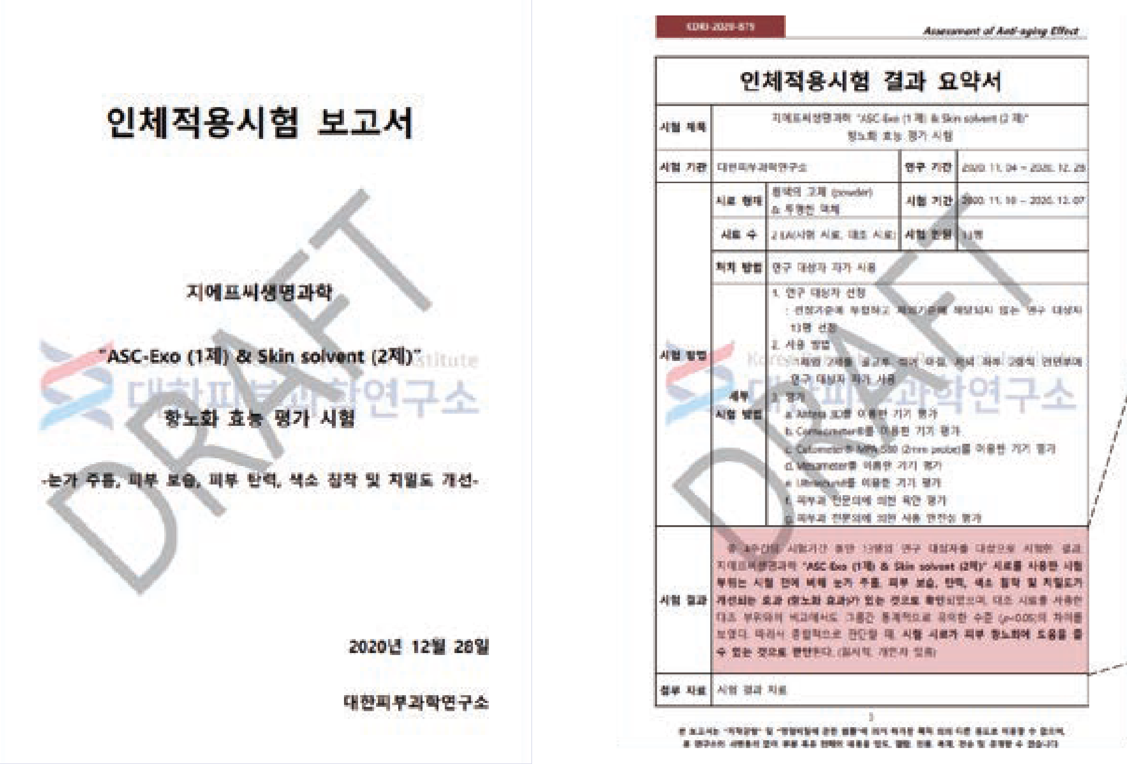
Adipose-Derived Stem Cell Exosome
Anti-Aging Efficacy Evaluation Test Completed
(KDRI-IRB-20879)

Slide 28
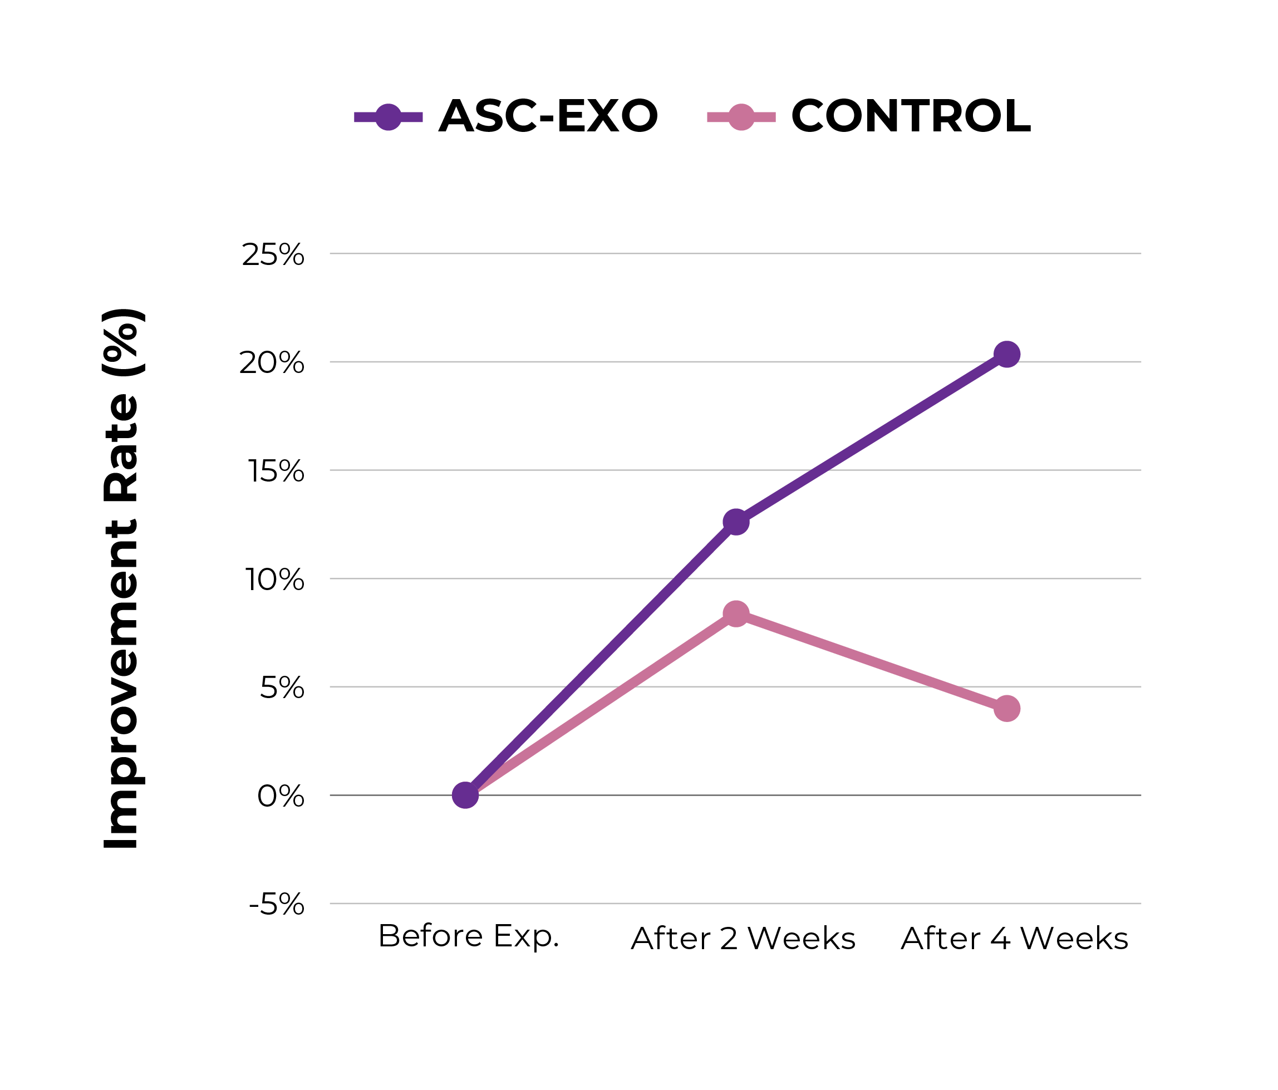
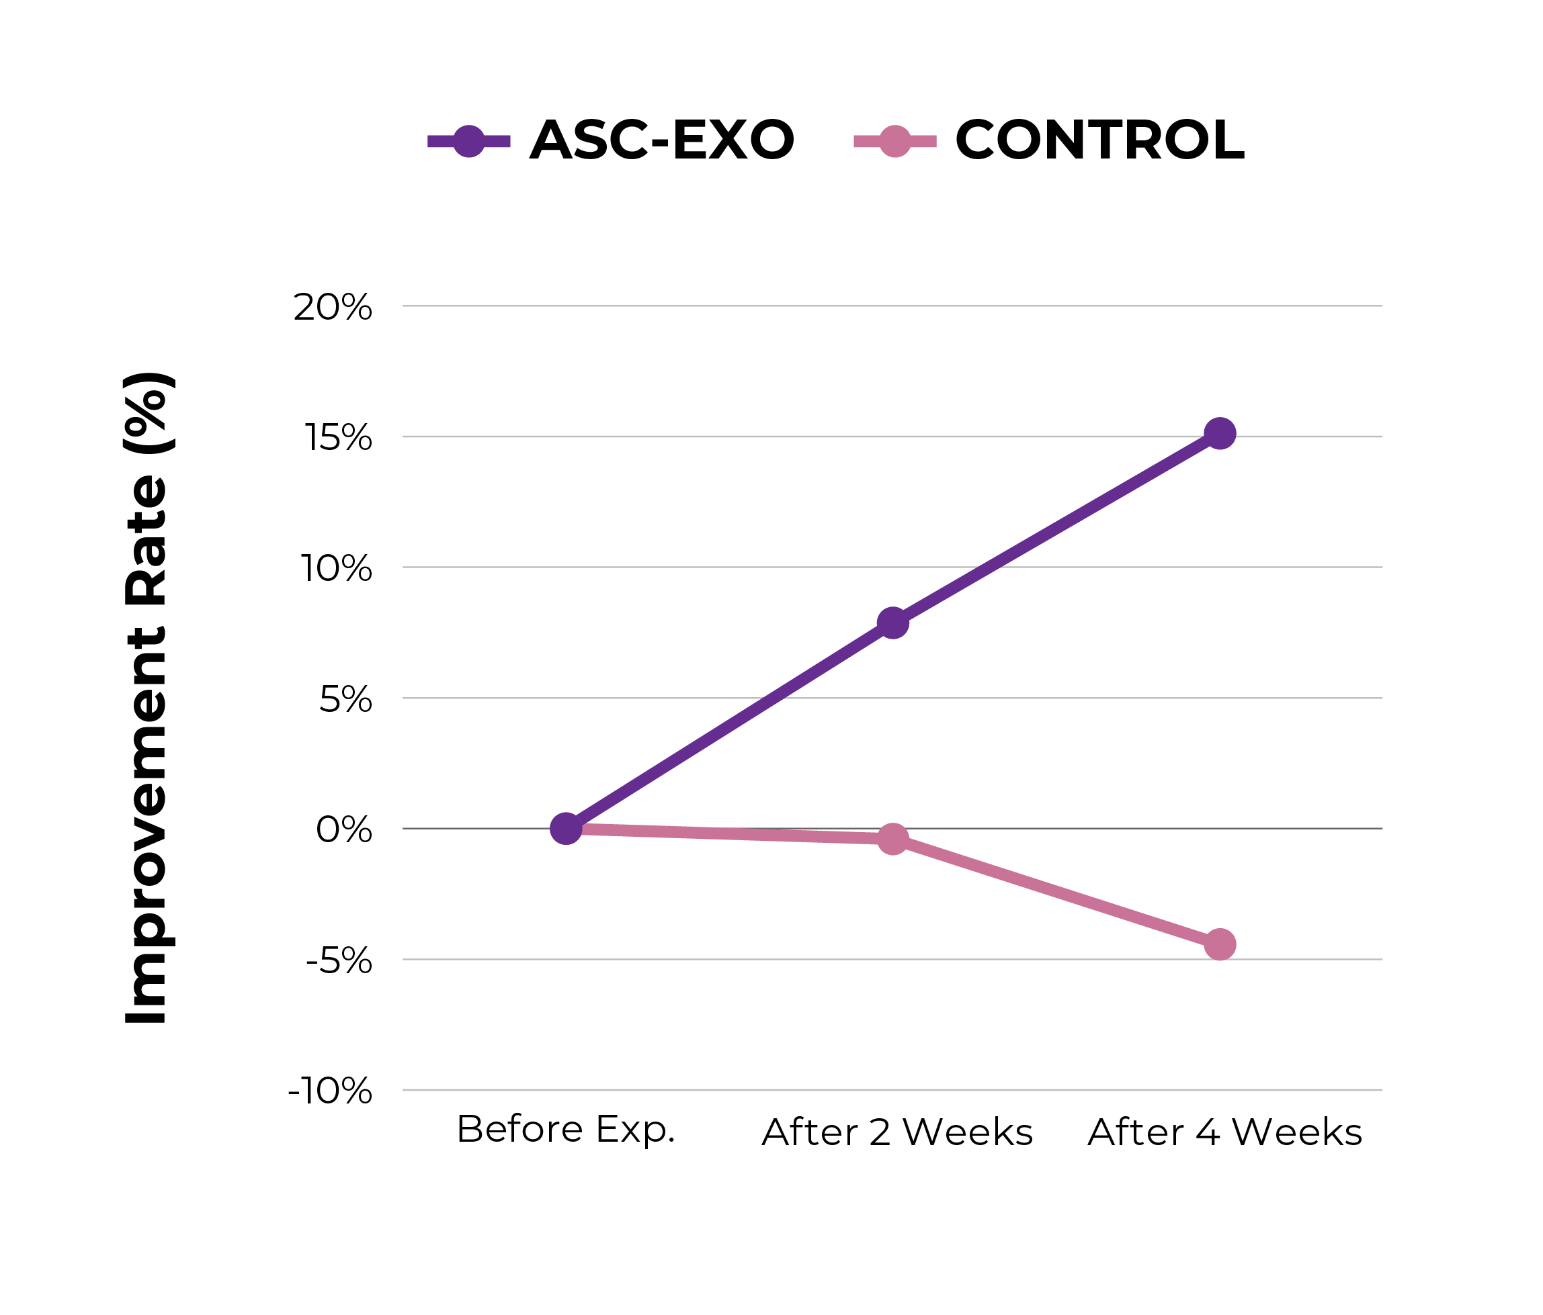
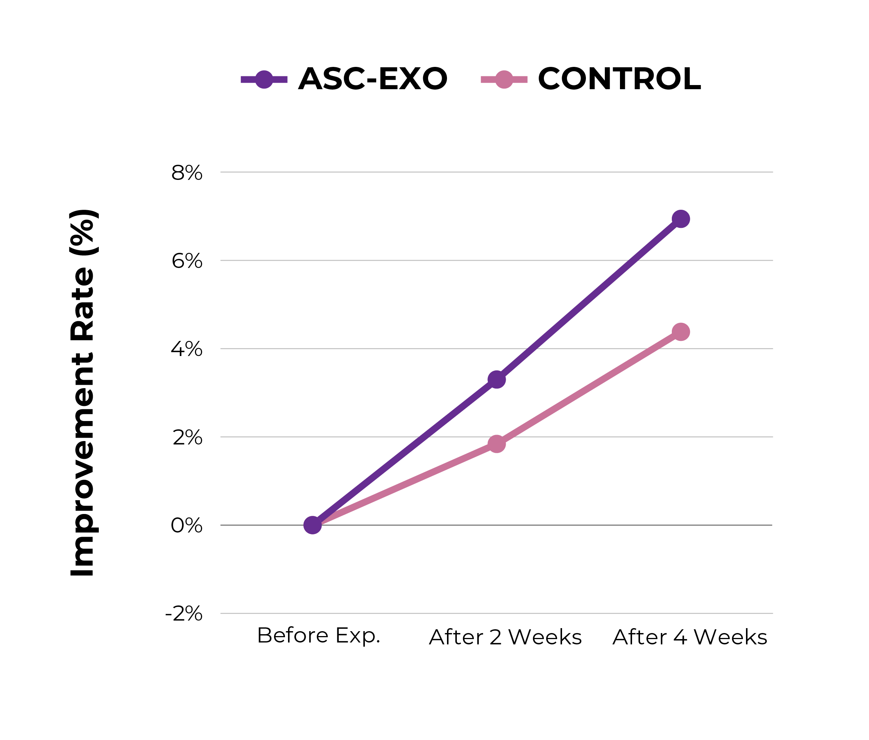
Adipose-Derived Stem Cell Exosome
Skin Application Results for 4 Weeks
Increase Skin Moisture Content
Increase Skin Elasticity
Skin Whitening Effect
Skin Moisture Content Increased by 20.35%
Skin Elasticity Increased by 15.12%
Inhibition of Melanin Content (6.94%) Confirmation of Skin Whitening Effect

Slide 29
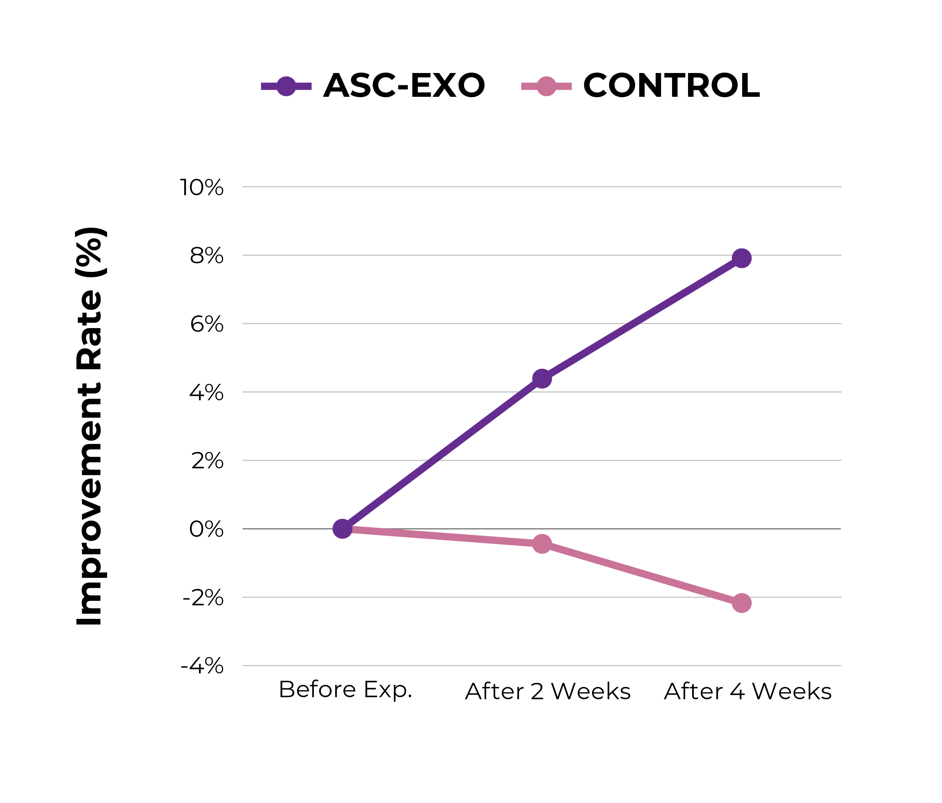
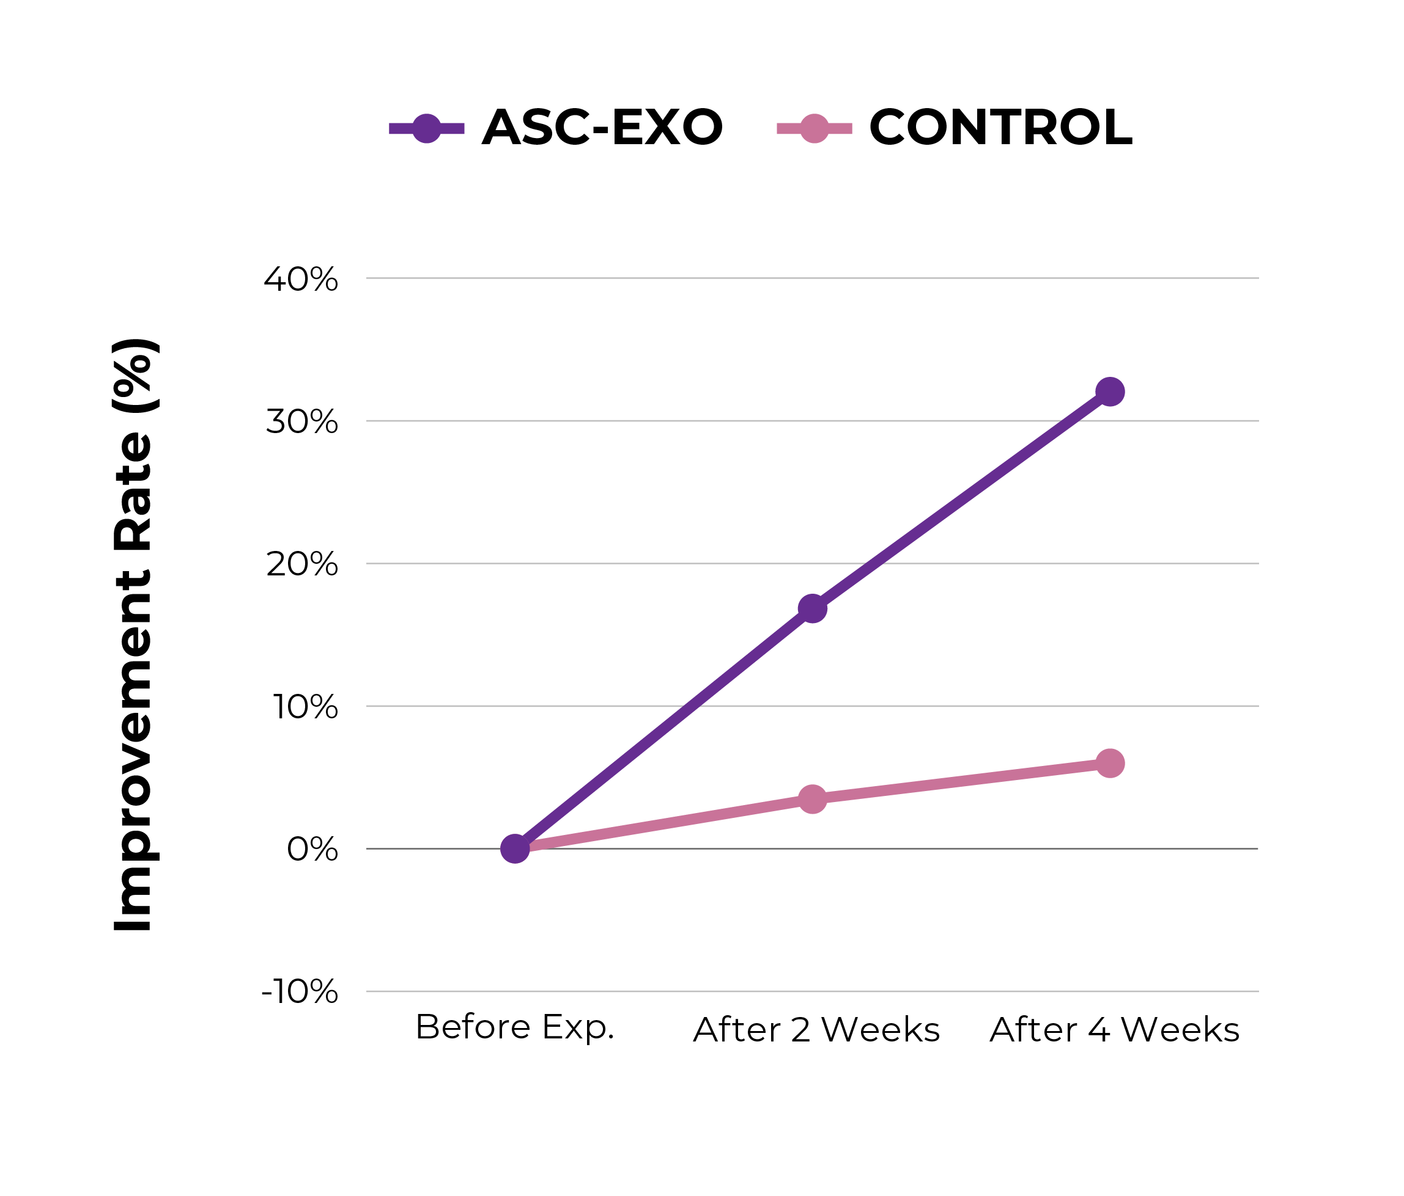
Adipose-Derived Stem Cell Exosome
Skin Application Results for 4 Weeks
Wrinkle Improvement
Improvement of Skin Density
7.91% Reduction in Wrinkle Depth
32.04% Increase in Skin Density

Slide 30
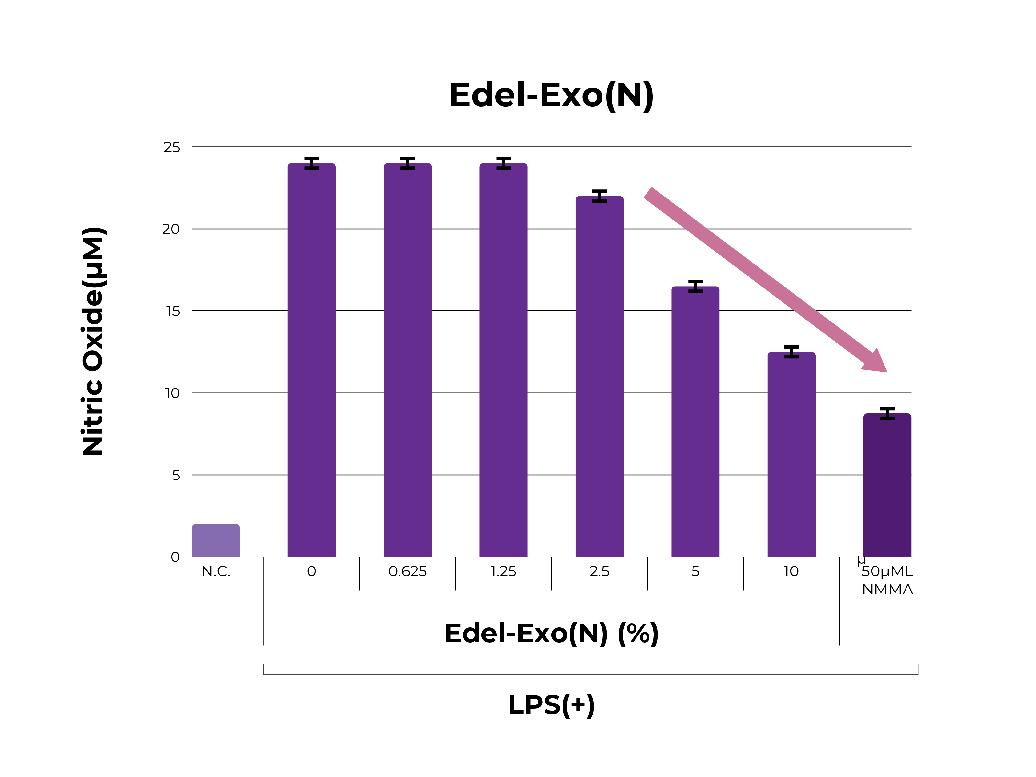
Edelweiss-Derived Exosome
Edelweiss’ Skin Benefits
Anti-Inflammatory Activity
Inhibition of 51.31% production of nitric oxide, an inflammatory factor

Slide 31
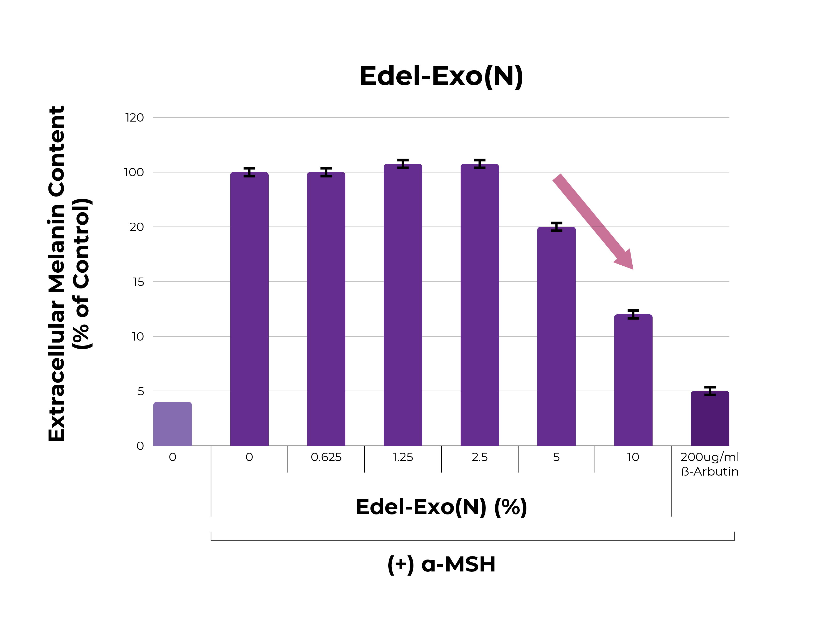
Edelweiss-Derived Exosome
Edelweiss’ Skin Benefits
Whitening Effect
52.37% decrease in extracellular melanin secretion

Slide 32
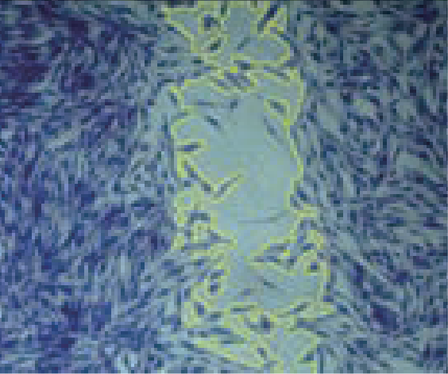
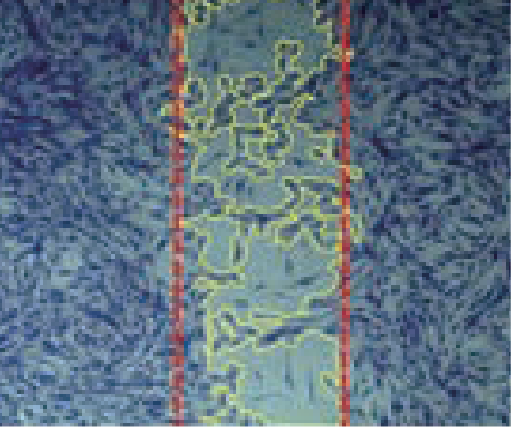
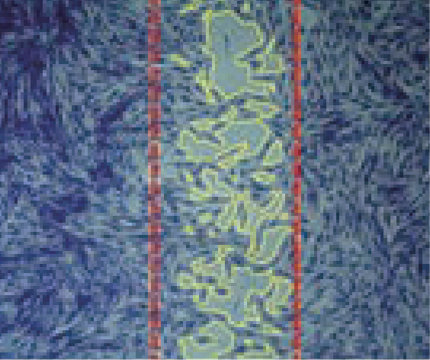
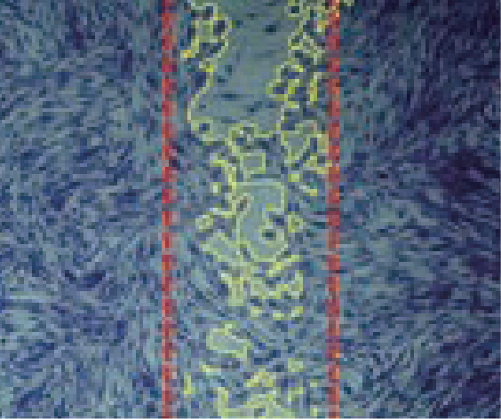
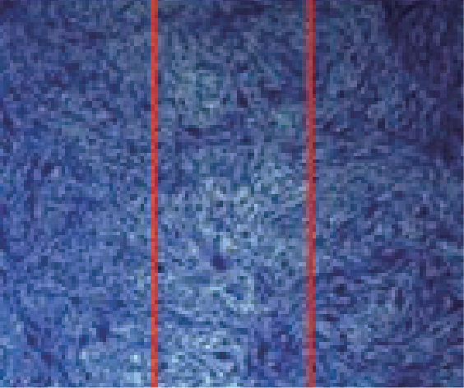
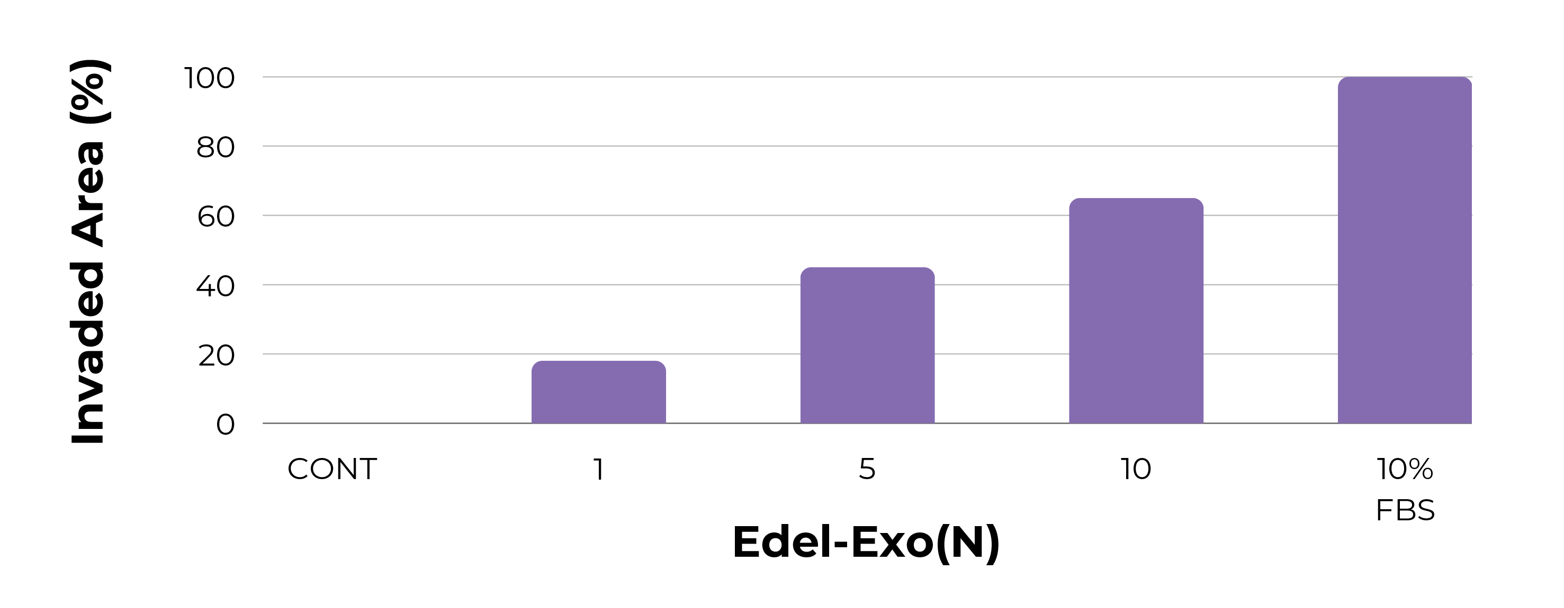
Edelweiss-Derived Exosome
Skin Cell Regeneration Effect
Control Group
2.5%
5%
10%
FBS 10%
Confirmation of skin regeneration effect
of plant-derived exosomes (Edel-Exo)
62.68% reduction in wound area when treated with 10% concentration

Slide 33
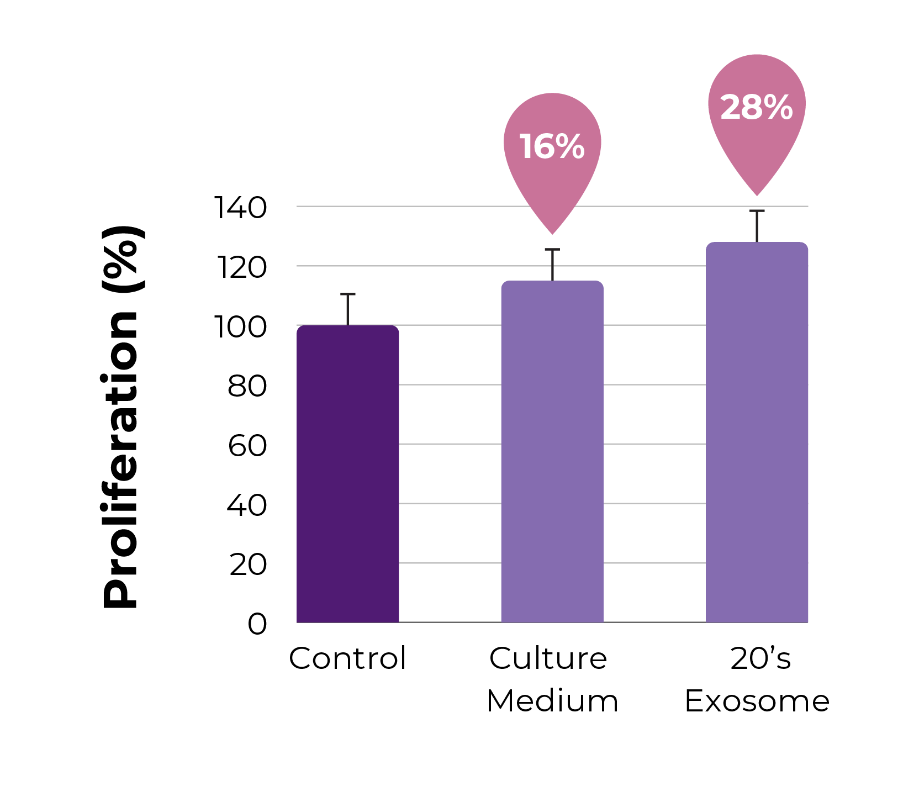
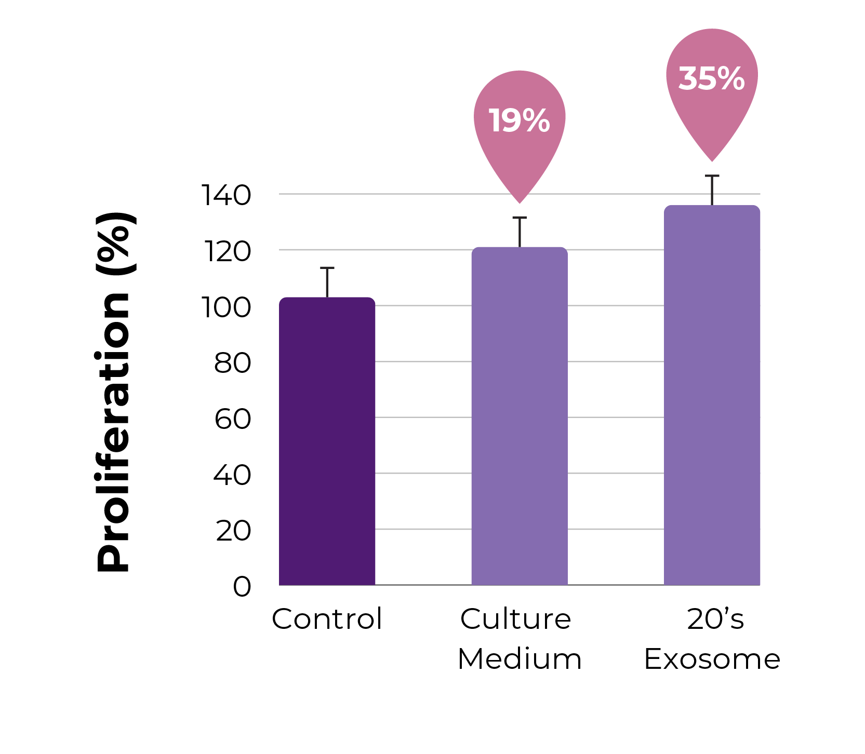
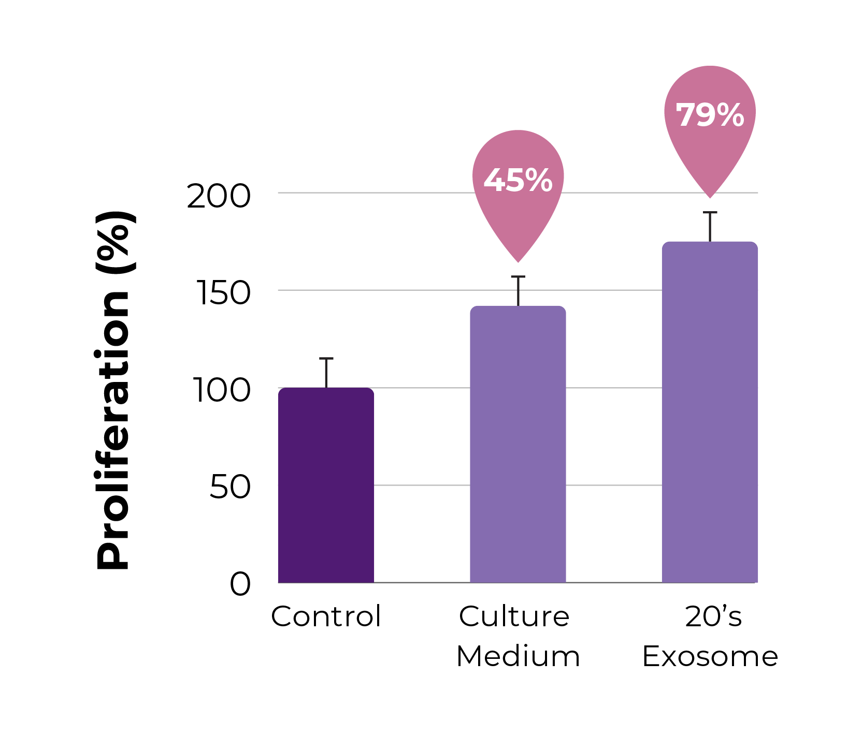
Skin Lactobacillus-Derived Exosome
Skin Cell (HaCaT, HDF) and Stem Cell Regeneration Effect
HaCaT Cell Proliferation
HDF Cell Proliferation
Stem Cell Proliferation

Slide 34
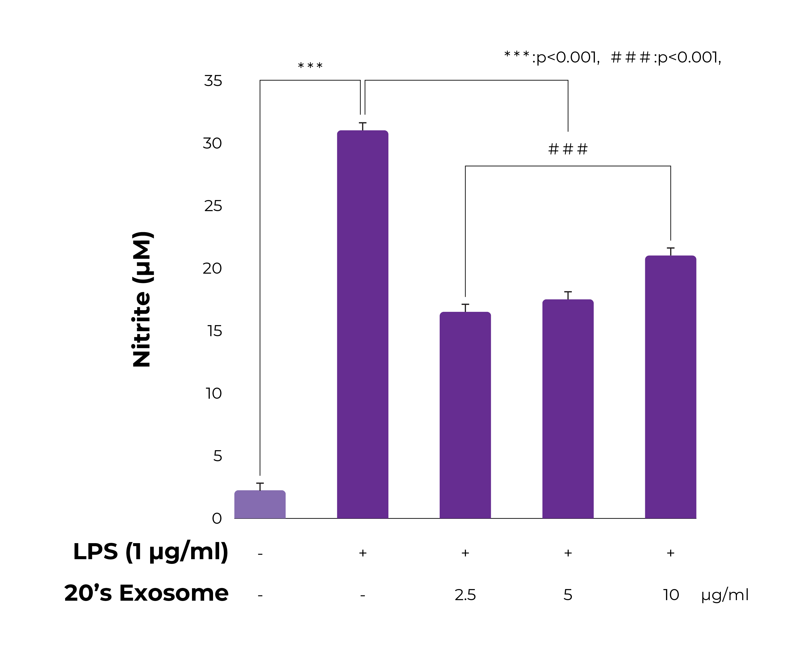
Skin Lactobacillus-Derived Exosome
Anti-Inflammatory Effect
It suppresses the generation of nitrogen oxide, an inflammatory marker, by more than 50% in inflammatory immune cells and does not affect immune cell proliferation.

Slide 35
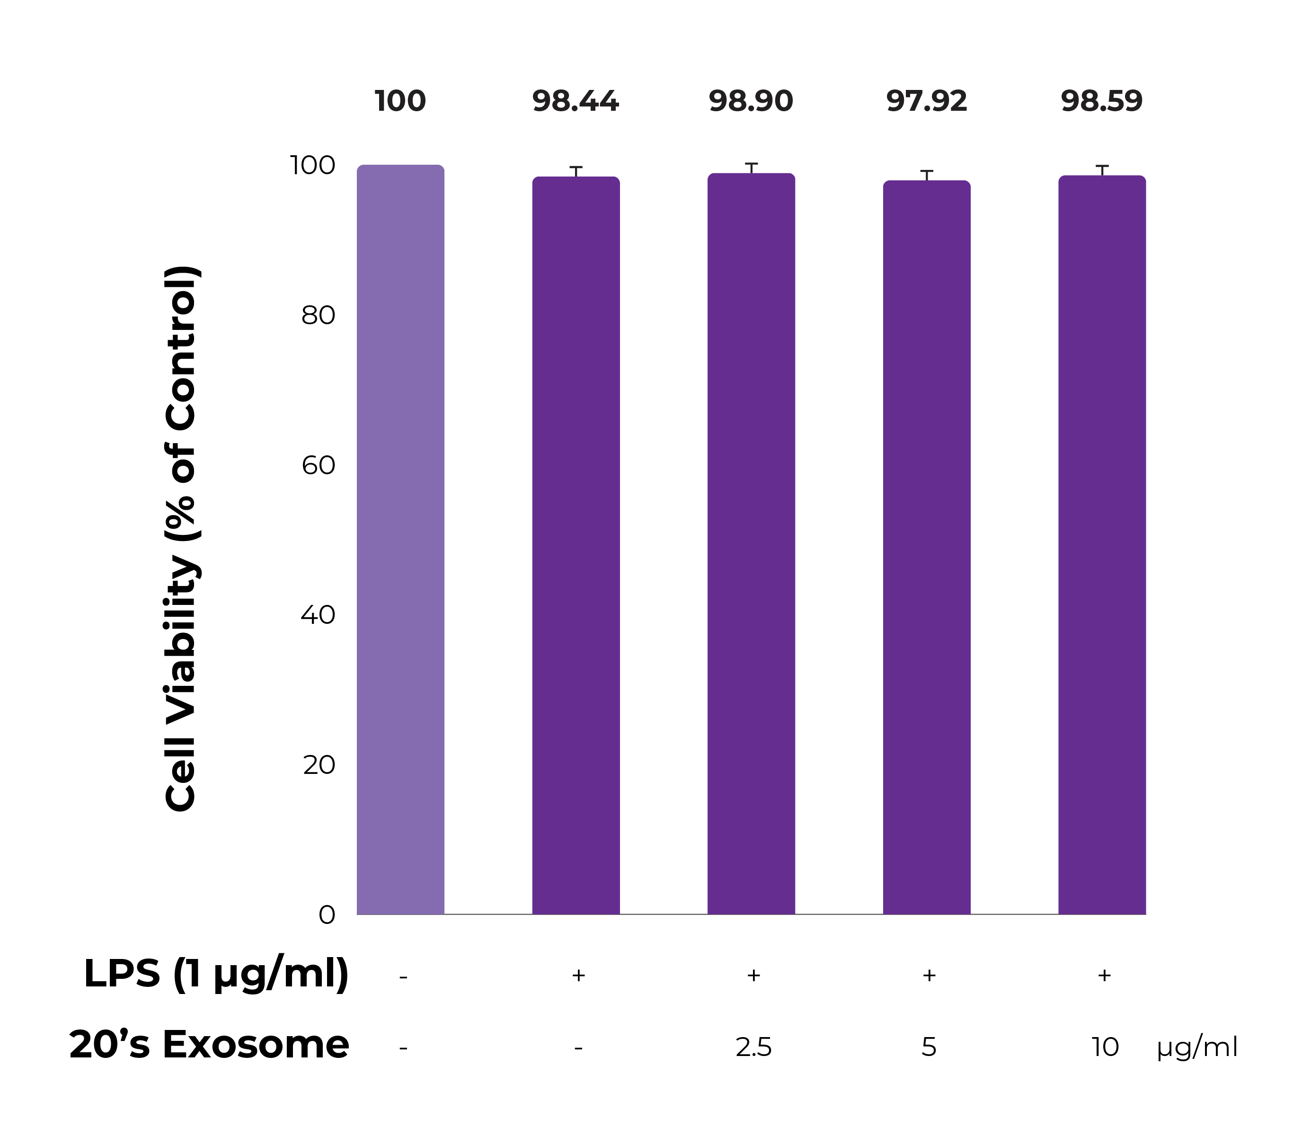
Skin Lactobacillus-Derived Exosome
Anti-Inflammatory Effect
It suppresses the generation of nitrogen oxide, an inflammatory marker, by more than 50% in inflammatory immune cells and does not affect immune cell proliferation.

Slide 36
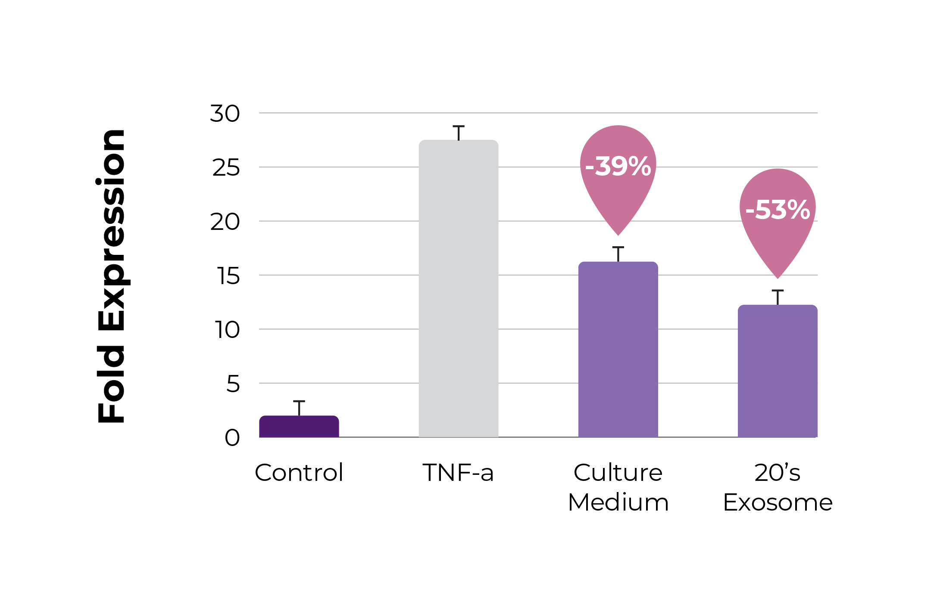
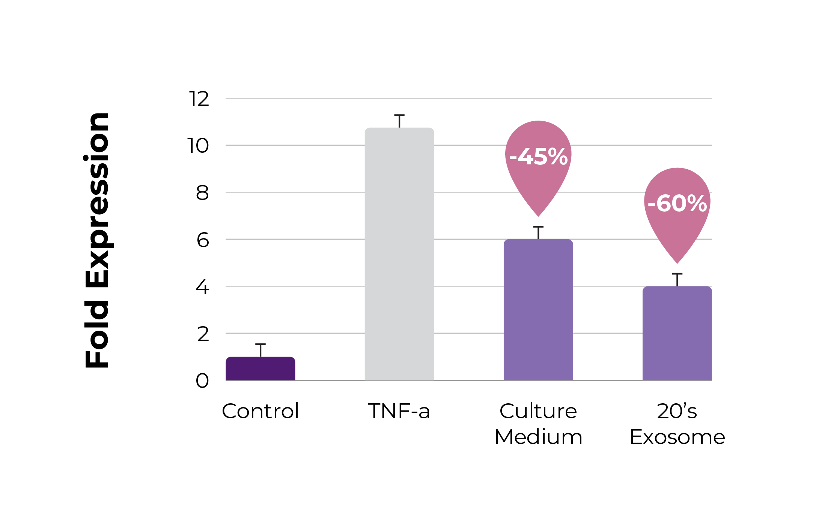
Skin Lactobacillus-Derived Exosome
Skin Balancing Effect
IL-6 Expression
IL-8 Expression

Slide 37
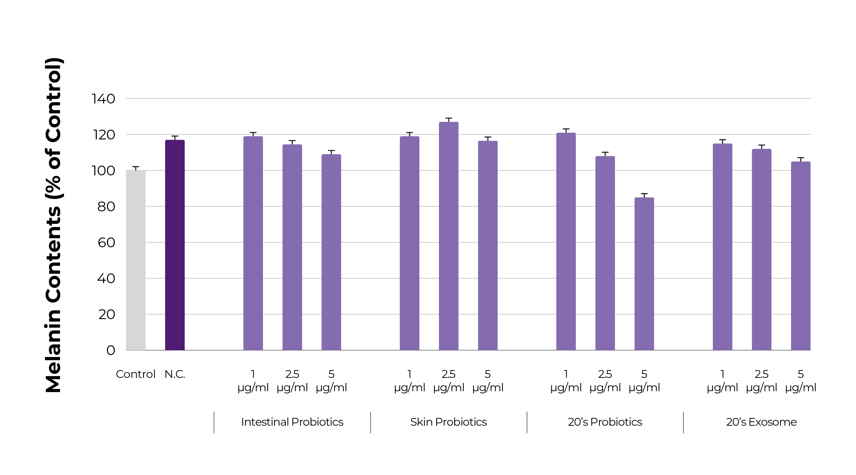
Skin Lactobacillus-Derived Exosome
Whitening Effect
Confirmation of melanin production inhibitory effect in melanin-producing cells (Melanoma) As a result of processing the exosome separated through the gut-skin axis, the best whitening effect was confirmed

Slide 38
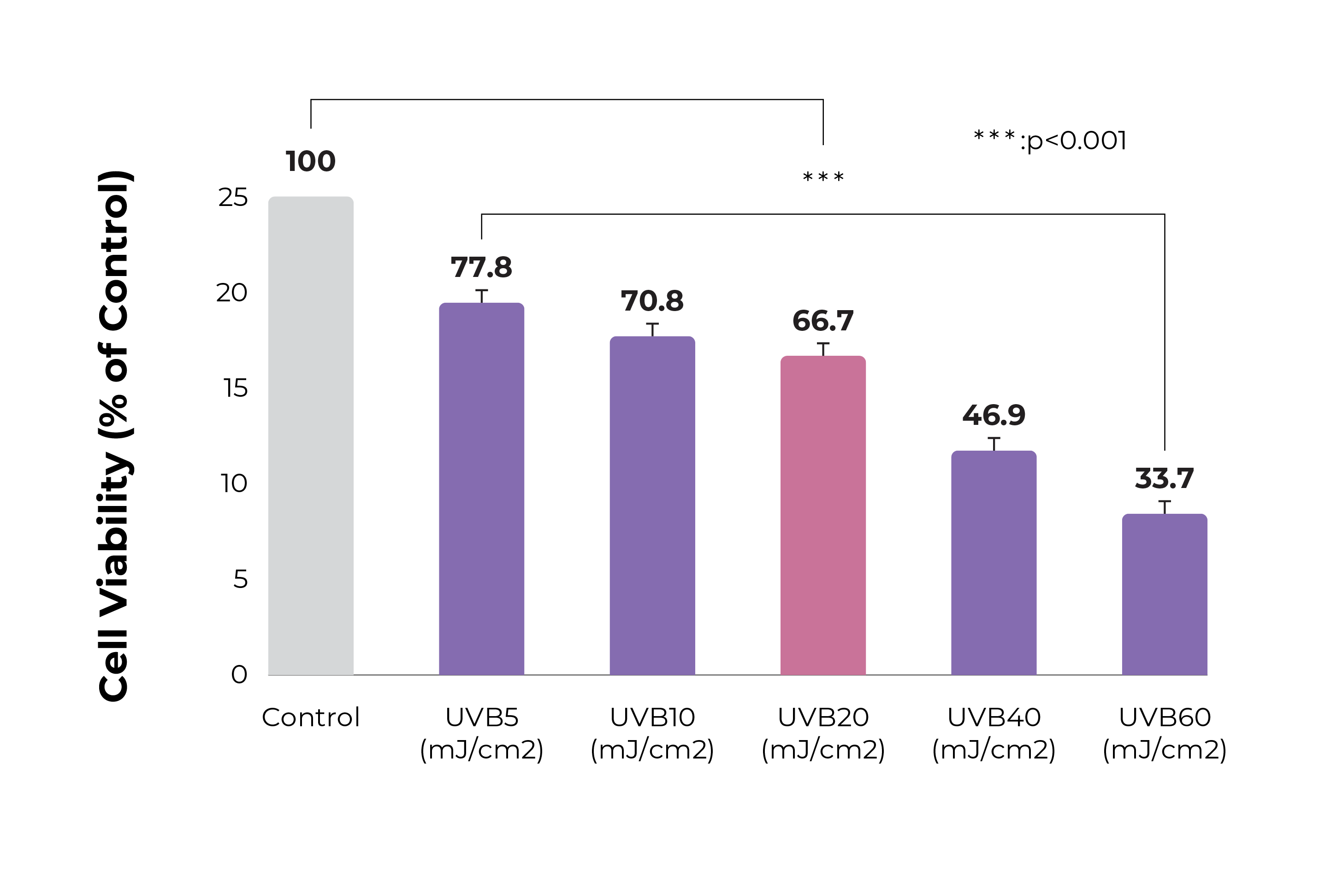
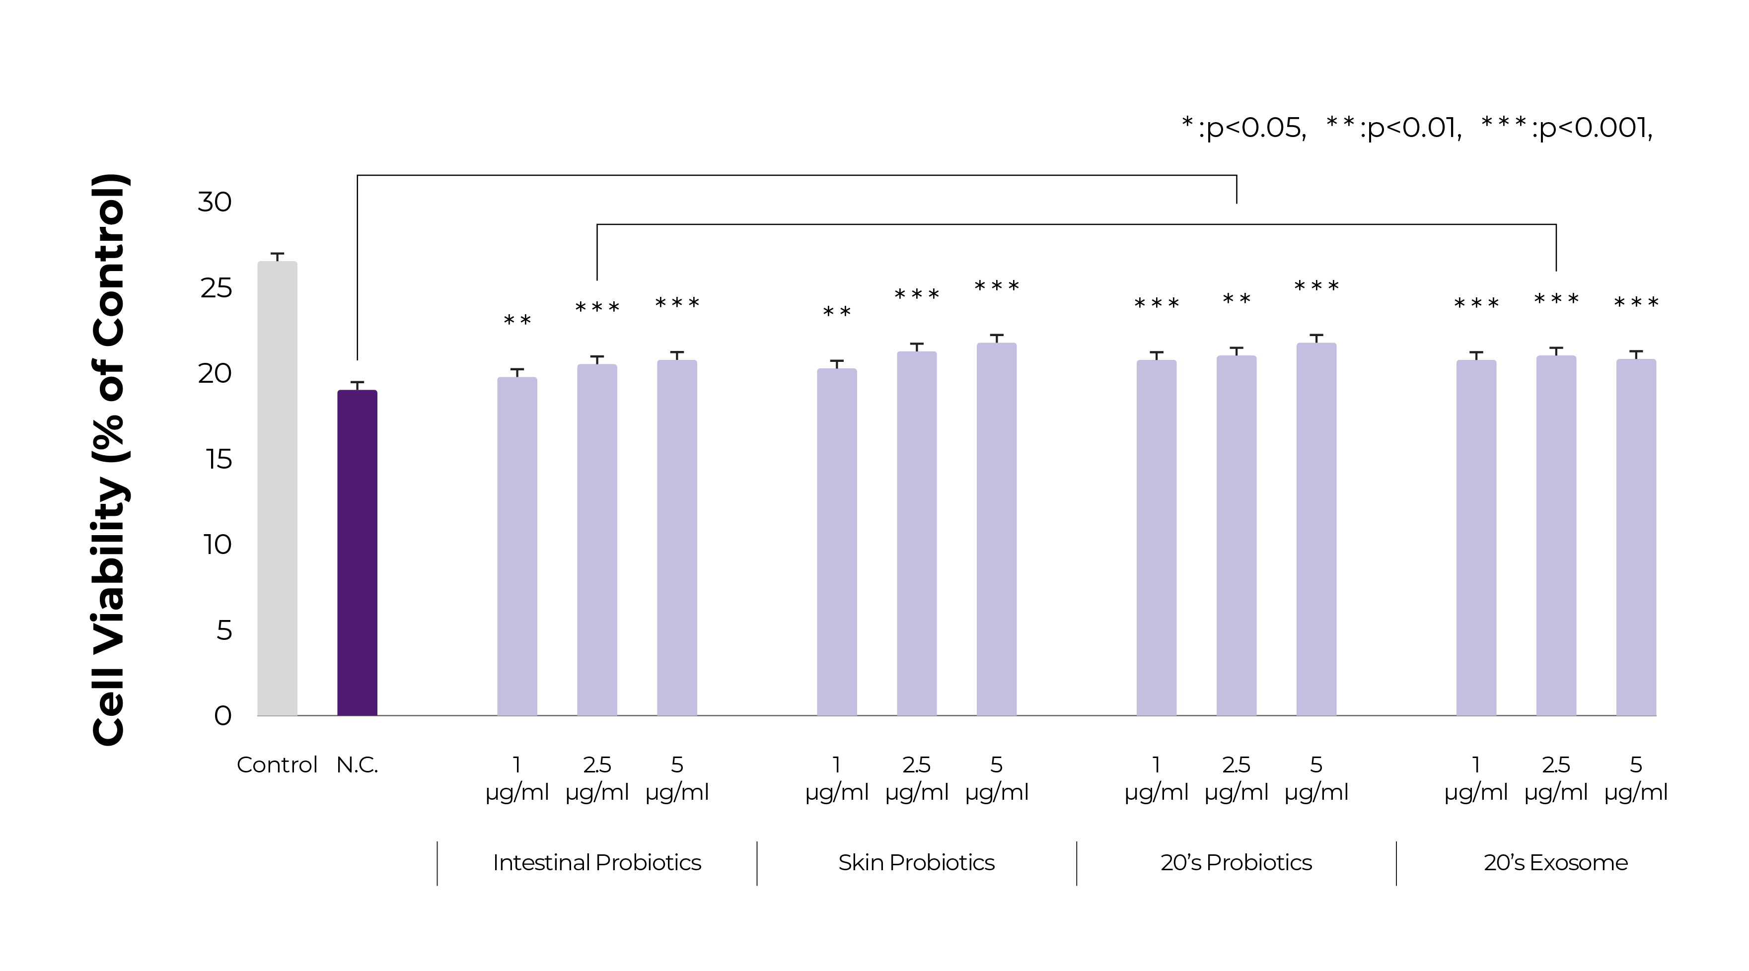
Skin Lactobacillus-Derived Exosome
Anti-Aging Effect
Confirmation of phototoxicity protection effect by UVB treatment in skin cells. As a result of processing the exosome separated through the gut-skin axis, the best protective effect was confirmed

Slide 39
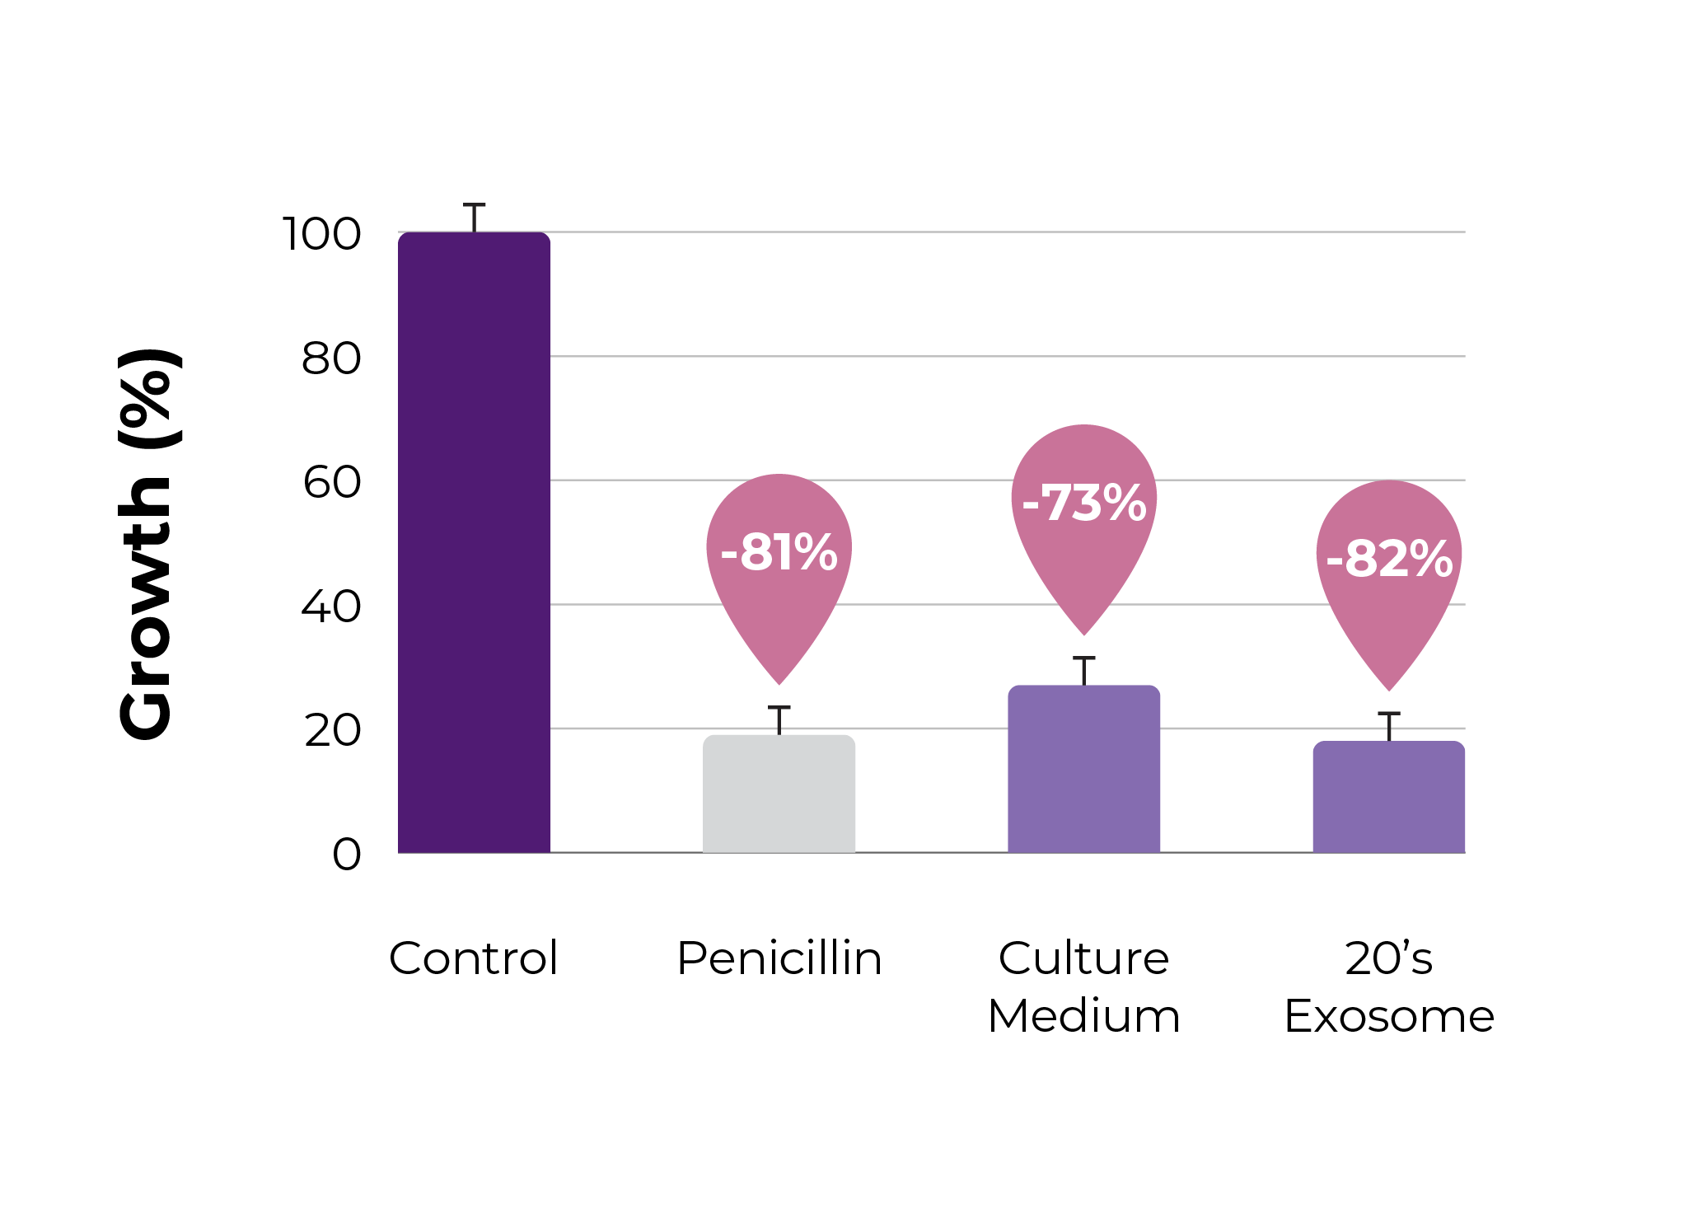
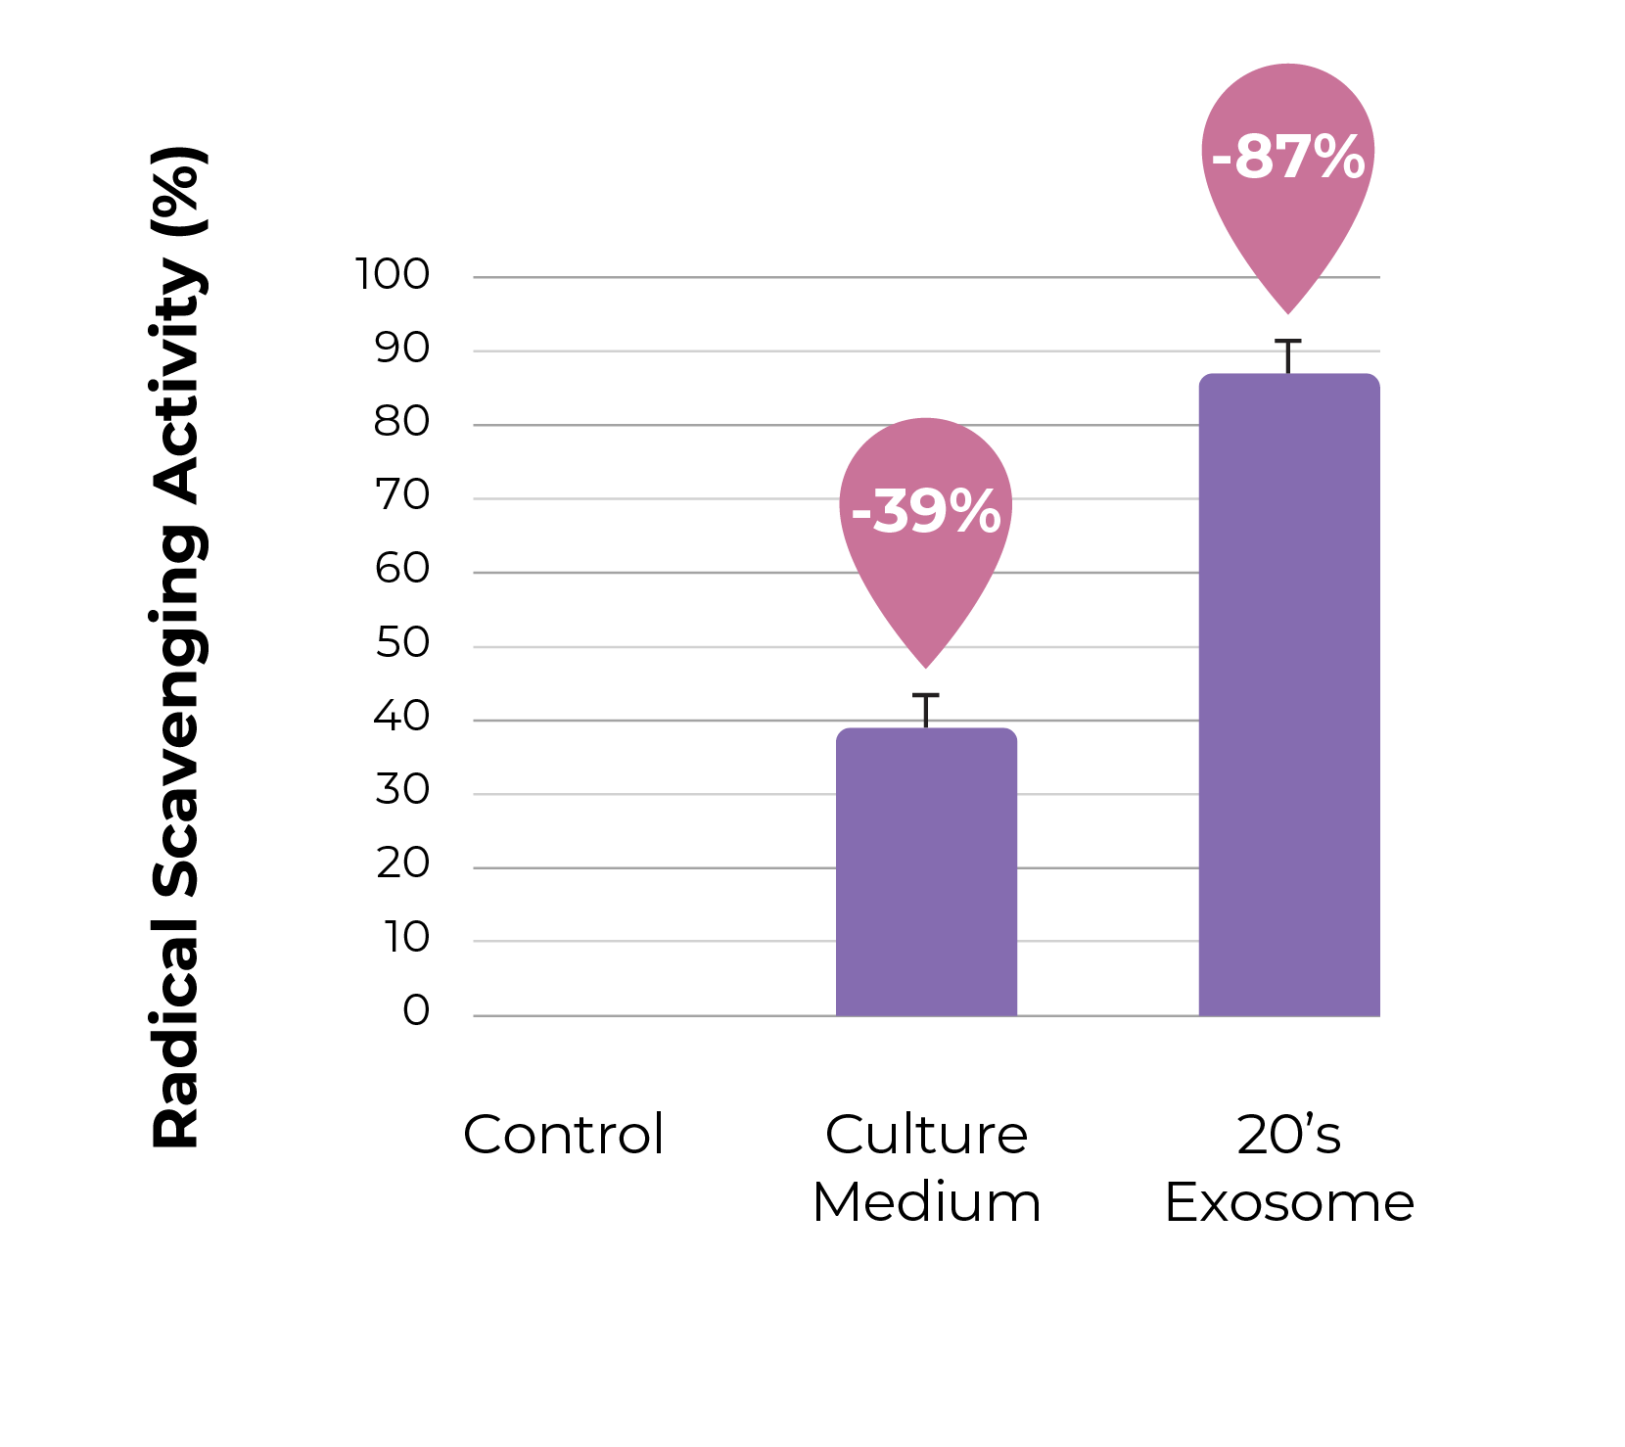
Skin Lactobacillus-Derived Exosome
Antibacterial & Antioxidant Effects
Staphylococcus Aureus Growth
DPPH Radical Scavenging Activity
It suppresses the proliferation of harmful bacteria that cause skin inflammation, balances skin microbes, and anti-aging effects can be expected.

Slide 40
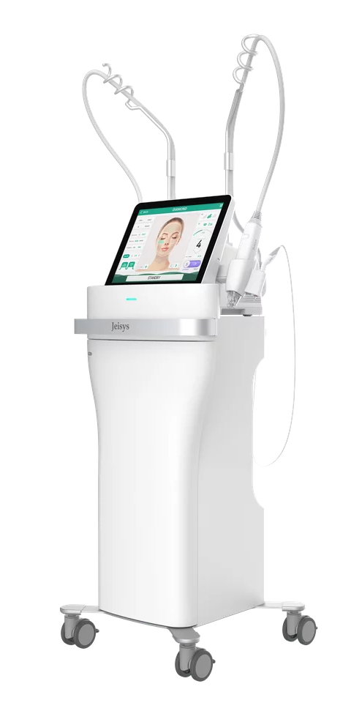
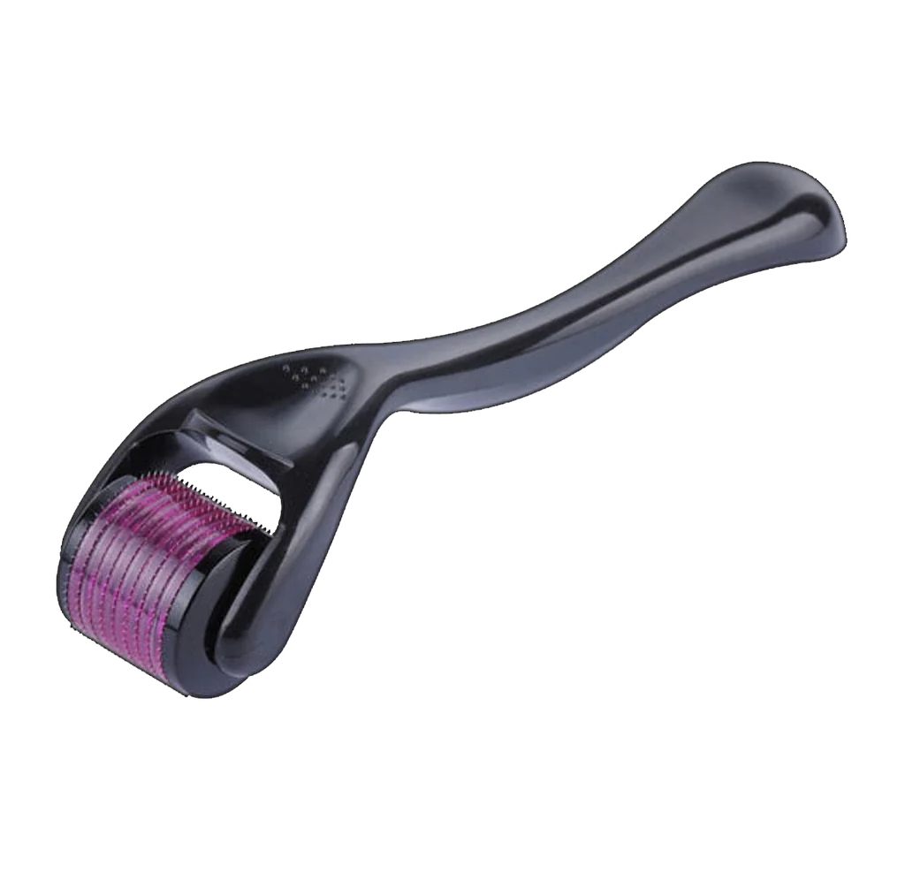
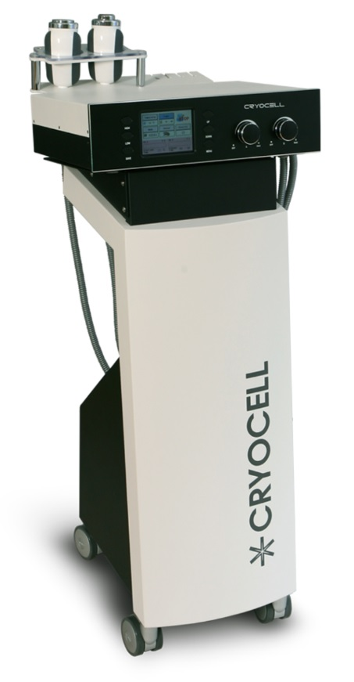
Protocol
02 Skin Improvement
If combined with equipment such as Potenza and Secret Laser, which are known to have excellent pore and scar improvement effects, more excellent effects can be expected.
01 MTS
It helps the skin regenerate naturally by injecting active ingredients after making tiny holes on the skin surface with thin and sophisticated ultra-fine needles.
03 Smooth
Combined with equipment such as Cryocell, LDM, and LED for the purpose of soothing management after skin treatment, it not only relieves swelling and pain after treatment, but also helps skin recovery and regeneration.

Slide 41





Revolutionizes skin health by nurturing its inherent strength at its core.
The Regenerative Skincare Solution
Exotop’s three exosome combinations maximize each other's synergy,
It not only supplies nutrients to the skin, but also solves skin problems more effectively.
Regeneration Promotion
Skin
Protection
Inflammation
Relief
Improve
Skin Tone
Hydration

Slide 42




The Regenerative Skincare Solution
Contains Three Types of Exosomes
Exotop contains a special combination of three exosomes, so it is more effective for skin regeneration, inflammation relief, and whitening.
Independent Clinical Trials
By merging with the ‘Korea Dermatological Research Institute’ and conducting human body application tests on its own, safer and more stable products can be used with confidence.
Manufactured in Class 100 Facility
It does not contain antibiotics and preservatives as it is manufactured in a facility that is close to sterile and contains less than 100 particles with a particle size of 0.5㎛ or more and less than 0.1 bacteria in 1 ft3 (28.4ℓ) of air.
Safe Manufacturing
We do not use animal-derived substances (FBS) or antibiotics in the process of culturing stem cells and producing exosome. From raw materials to finished products, it passes various microbiological tests and is supplied in an aseptic state.

Slide 43
Copyright 2023 | Exotop™ | All rights reserved.

