Slide 1
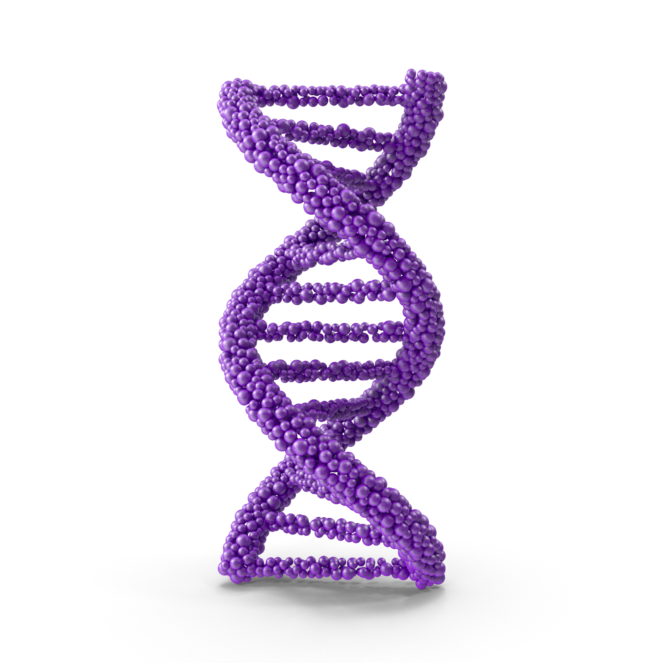
Adipose-Derived Stem Cell Exosome
It contains about 250 kinds of growth factors, so it promotes various cell division, growth and differentiation
Contains about 250 kinds of growth factors to promote various cell division, growth and differentiation
Contains exosomes - Only 0.1% of stem cell culture medium exists - Nano vesicles with a size of 50-200 nm, containing various genetic information materials within cell
Contains cytokines - One of the peptides as a glycoprotein that acts as a signal substance in the body - Combines with receptors of target cells to express various activation mechanisms within cells

Slide 2
Adipose-Derived Stem Cell Exosome
It contains about 250 kinds of growth factors, so it promotes various cell division, growth and differentiation
01 Obtaining adipose tissue and securing adipose-derived stem cells
03 Exosome Detection
Exosome Analysis equipment
Confirmed by Brownian motion of particles by NTA (Nanoparticle Tracking Analysis) analysis [number of particles (Particle/mL), particle size]
TEM image analysis (Transmission electron microscopy)
Exosomal specific markers (CD9, CD63, CD81(Tetraspanin), TSG101, Flotillin1, Alix etc.)
Securing adipose tissue
Securing fat-derived stem cells
Securing adipose-derived stem cell culture medium
02 Donor eligibility check
Confirmation of donor eligibility
Confirmation of congenital or chronic disease test
Confirmation of contagious spongiform encephalopathy test
Consent to use adipose tissue’

Slide 3
Adipose-Derived Stem Cell Conditioned Media — Main Ingredients
Exotop™ contains high concentrations of growth factors (EGF, HGF, VEGF, TGFβ, FGF, KGF, GF-1) and extracellular matrix proteins (Collagen, Fibronectin).
EGF
HGF
VEGF
TGFβ
FGF
KGF
IGF–1
Extracellular Matrix

Slide 4
It contains about 250 kinds of growth factors, so it promotes various cell division, growth and differentiation.
Adipose-Derived Stem Cell Conditioned Media — Growth Factors
Growth Factors & Functions
EGF
VEGF
Promotes cell proliferation. Promotes angiogenesis.
Promotes hair growth.
Promotes angiogenesis. Promotes fibroblast proliferation. Inhibits scar formation in wounds.
HGF
TGFβ
Anti-inflammatory function. Promotes cell migration and proliferation. Inhibits apoptosis. Promotes angiogenesis. Promotes hair growth.
Damaged tissue repair. Regulation of immune cell proliferation.

Slide 5
It contains about 250 kinds of growth factors, so it promotes various cell division, growth and differentiation.
Adipose-Derived Stem Cell Conditioned Media — Growth Factors
Growth Factors & Functions
aFGF
KGF
Promotes epithelial cell proliferation. Promotes production of collagen, hyaluronic acid, SOD, etc. in fibroblasts.
Promotes keratinocyte proliferation.
GF-1
bFGF
Promotes tissue regeneration. Promotes tissue growth.
Skin dermal regeneration factor. Wound healing effect.

Slide 6
Adipose-Derived Stem Cell Conditioned Media — Collagen & Fibronectin
ECM physically supports tissues by filling in the gaps between cells or surrounds cells to create an environment for cells to survive.
*(Left) Skin with sufficient extracellular matrix
(Right) Skin with insufficient extracellular matrix
Collagen
Maintain skin elasticity & strengthen skin tissue.
Fibronectin
Wound healing effect with skin components.

Slide 7
Copyright 2023 | Exotop™ | All rights reserved.

