Slide 1
Skin Lactobacillus-Derived Exosome
Made from fermented lactic acid bacteria from the skin of individuals in their 20’s, it is effective in skin whitening and
anti-inflammatory effects.
Identification of skin-derived lactic acid bacteria with more accurate sequencing technology than before isolation and identification of skin strains
Confirmation of lactic acid bacteria as a result of microorganism isolation and DNA identification from skin isolation of lactic acid bacteria from the skin of individuals in their 20’s
Lactobacillus planatarum
Skin in their 20’s contains about 1.23%, approximately 25 times more than those in their 50’s.
Reduction of acne-causing strains, anti-inflammatory effect, increase in lactic acid bacteria, strengthening of skin immunity, skin moisturizing, regeneration, anti-aging, protective film formation, tone-up, etc.

Slide 2
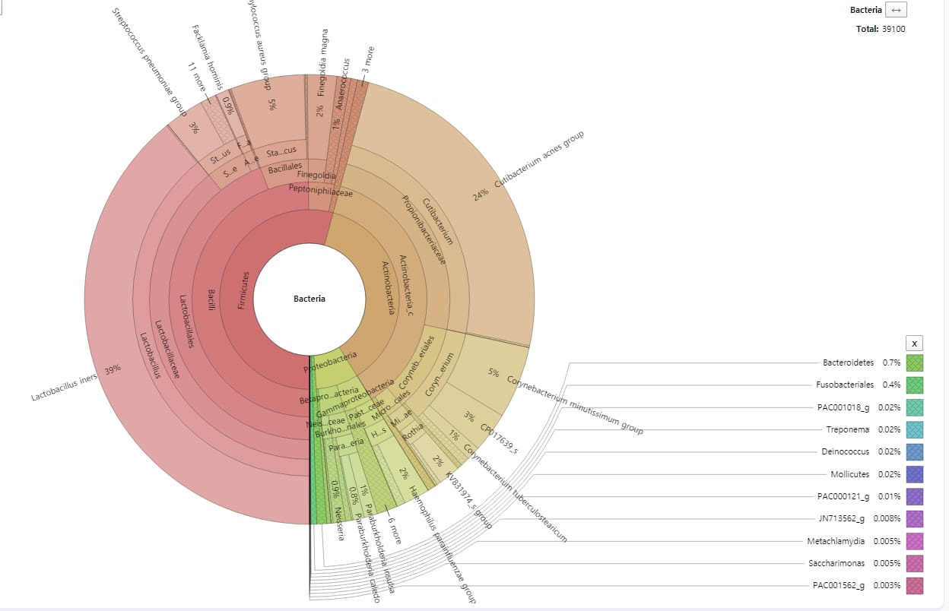
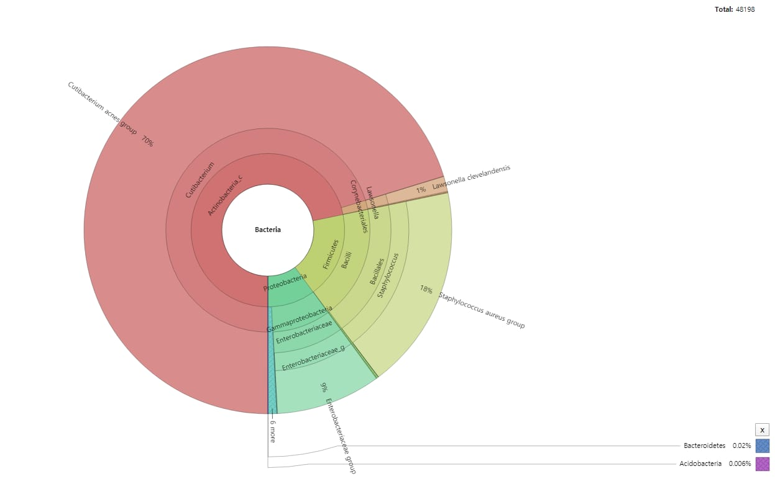
Skin Lactobacillus-Derived Exosome
Made from fermented lactic acid bacteria from the skin of individuals in their 20’s, it is effective in skin whitening and
anti-inflammatory effects.
[ Comparison graph before and after application ]
Confirmation of reduction of acne-causing strains and increase of lactic acid bacteria after application

Slide 3
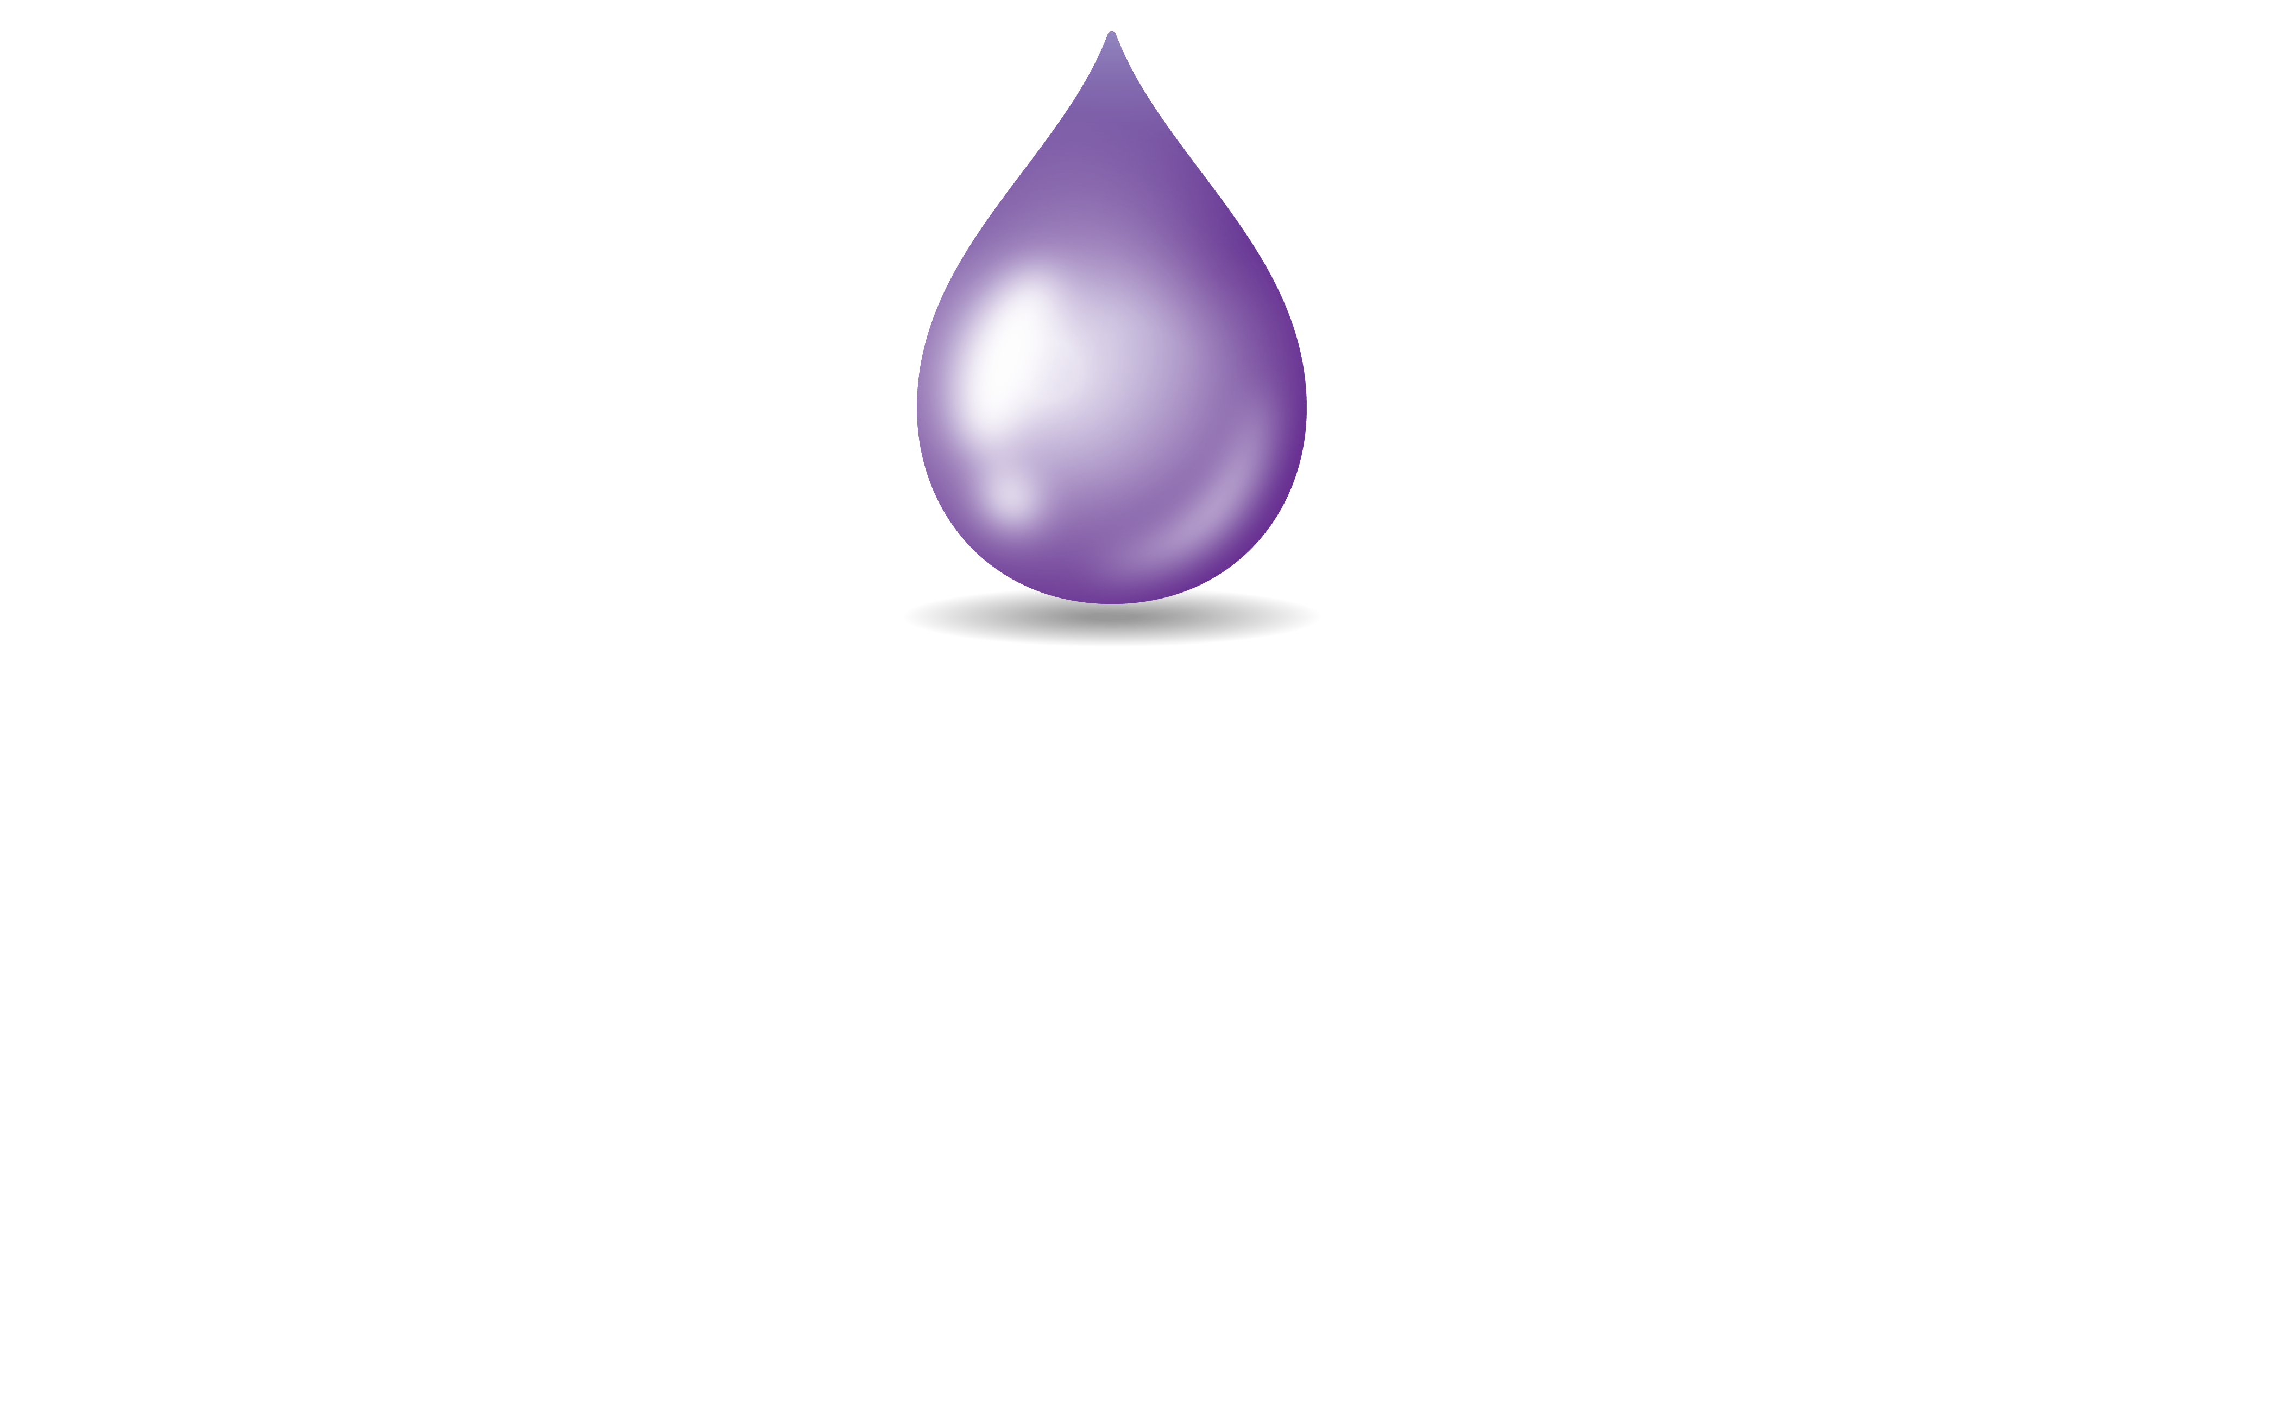
Copyright 2023 | Exotop™ | All rights reserved.

